Slide 1
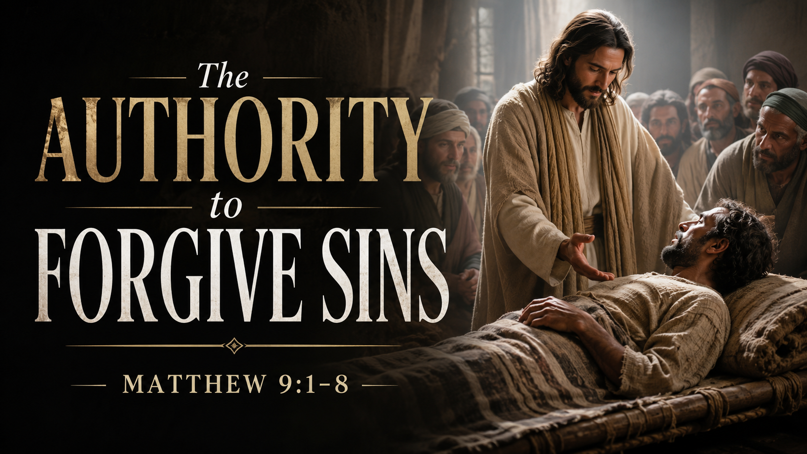
Notes:
This week, we’re starting Matthew chapter 9, where Jesus shows His divinity in “The Authority to Forgive Sins” in the first 8 verses…

Slide 2

Notes:
Heavenly Father, thank You for bringing us here today.
As we open Your Word, help us to see our true need and the beauty of Your forgiveness.
Teach us to stop hiding our guilt and to bring everything honestly before Christ.
Open our hearts to the authority of Jesus and remind us that no sin is greater than Your grace.
In Jesus’ name, amen.

Slide 3
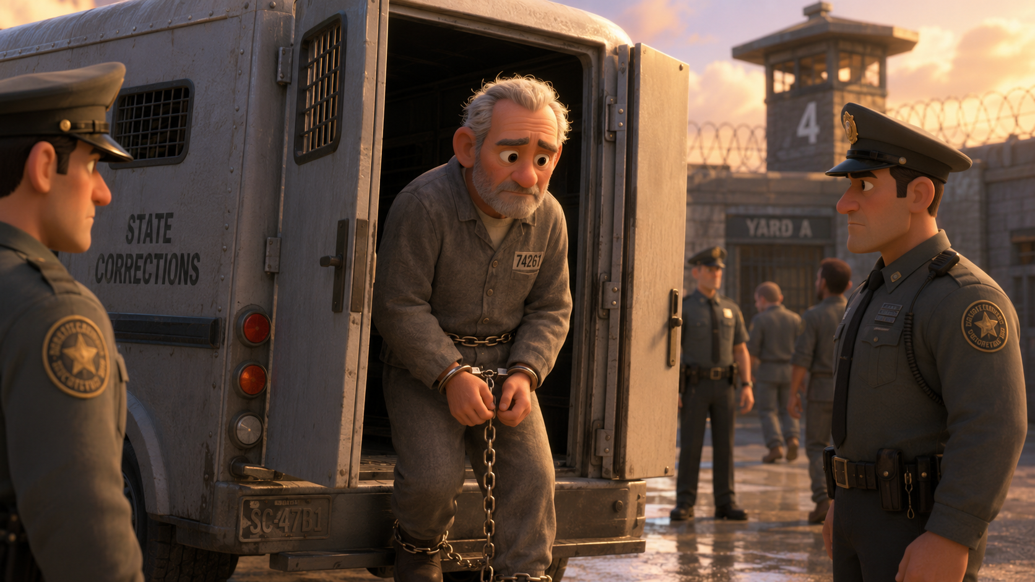
Notes:
A cold wind cut across the prison yard as the old man stepped out of the transport van.
Chains rattled softly around his wrists as he was being transferred to a different prison.
Not because he was dangerous anymore. Not because he might run.
But because thirty-eight years earlier, he had done something unforgivable.

Slide 4
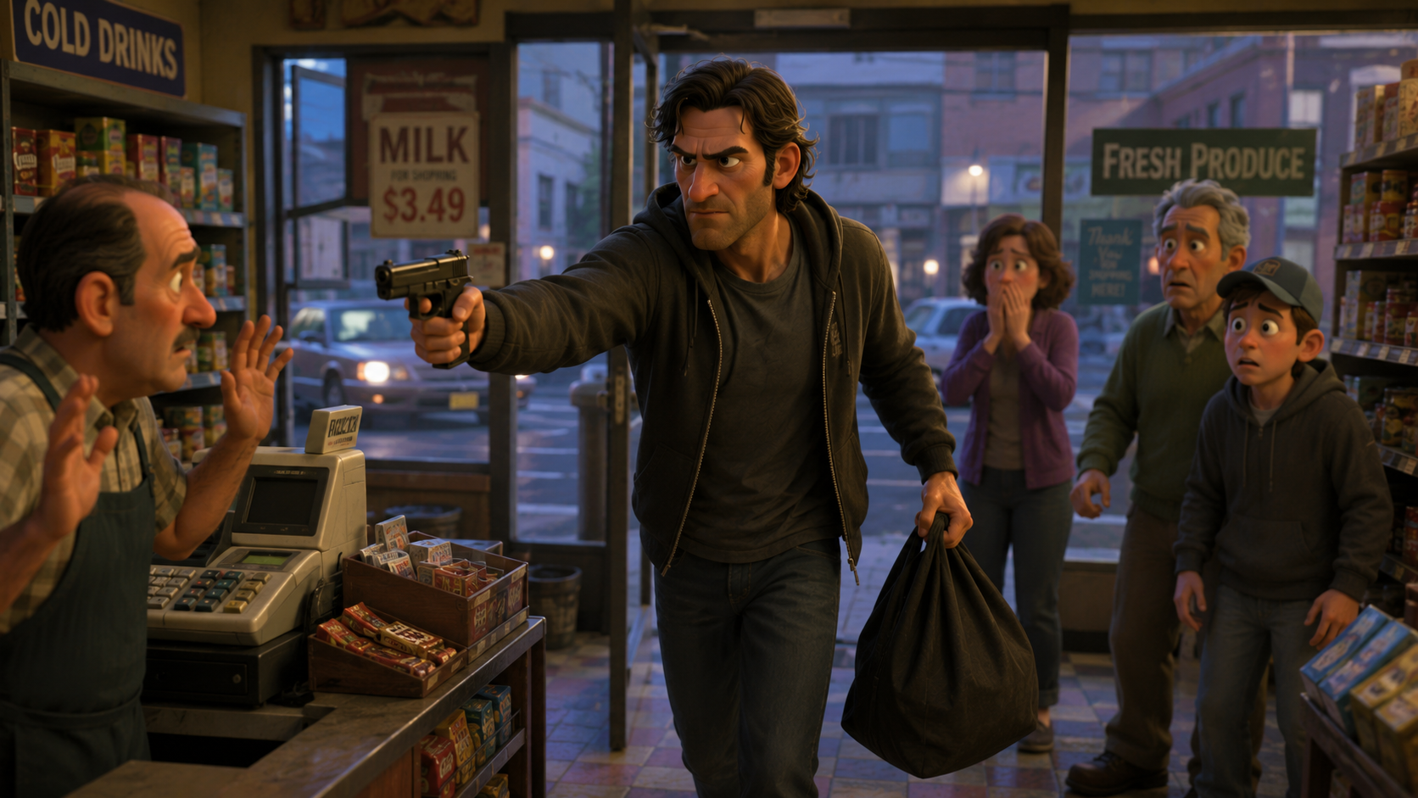
Notes:
He had walked into a small grocery store and committed a robbery that went terribly wrong.
A husband, a father of two, was killed in the chaos.
One terrible decision destroyed multiple lives in a matter of seconds.
The man spent nearly four decades in prison.
Most people forgot his name.

Slide 5

Notes:
But one person never could. The victim’s daughter.
She was only eight years old when her father died.
For years, she carried the weight of bitterness. Every birthday. Her graduation. Her wedding...
every moment where there should’ve been a father standing beside her. His absence haunted her life.

Slide 6

Notes:
And the hatred slowly poisoned her.
Not just emotionally, but:
Spiritually.
Physically.
Mentally.
She later admitted that she thought about revenge constantly.

Slide 7
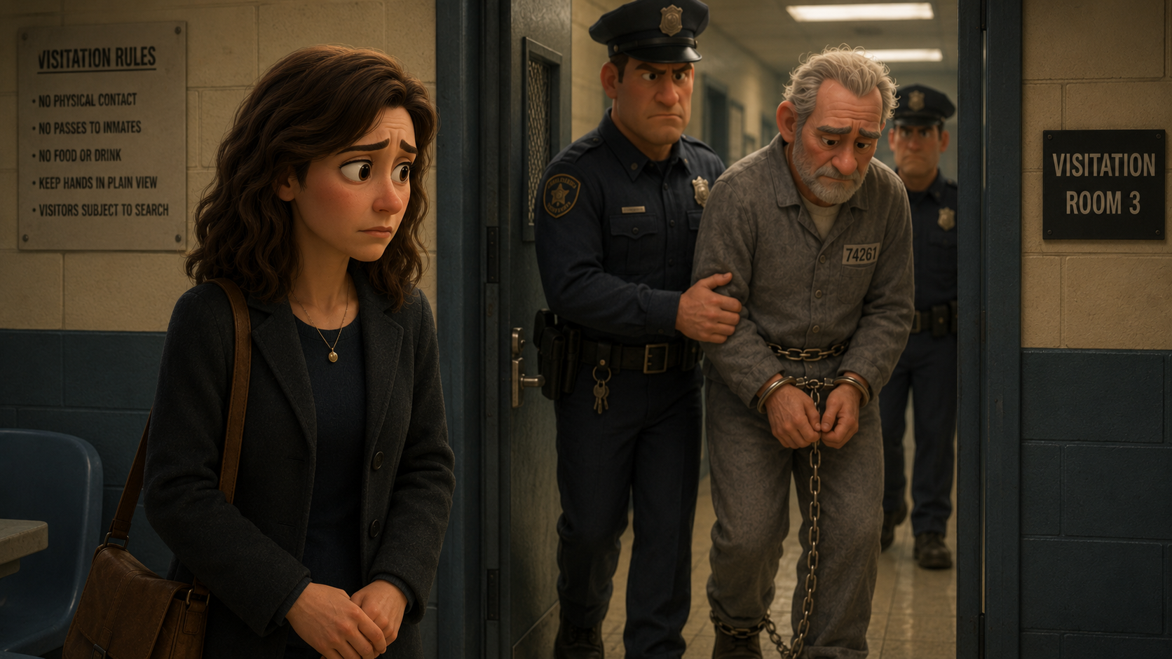
Notes:
Then one day, after years of wrestling with anger, she visited the prison.
Not for closure.
Not for answers.
And not for vengeance...
The guards escorted her into a small visitation room. The old man shuffled in slowly, unable to even lift his eyes toward her.

Slide 8
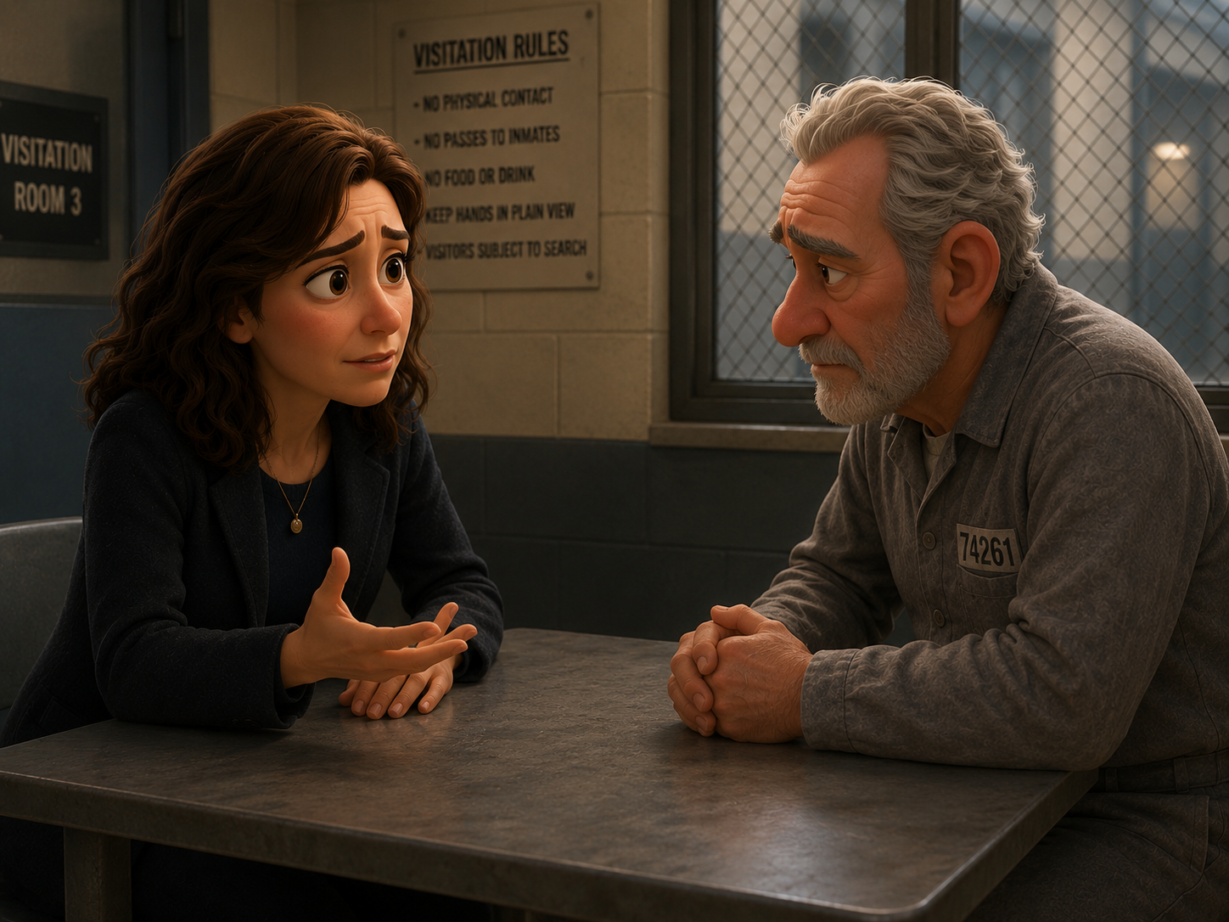
Notes:
He expected rage.
He expected accusations.
He expected to hear about how much destruction he had caused in her life.
Instead, after a long silence, she said something he never imagined hearing:
“I came here to tell you… I forgive you.”

Slide 9
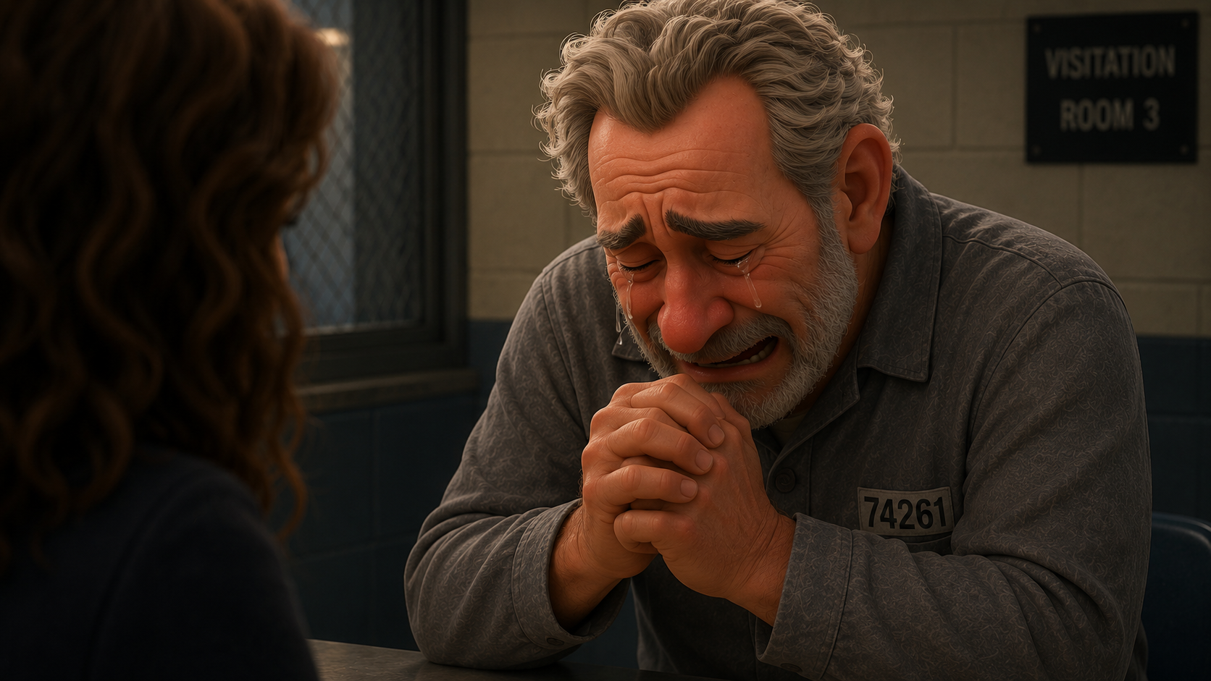
Notes:
The man reportedly broke down sobbing so violently that he could barely breathe.
Months later, when asked why she did it, she explained:
“Forgiveness didn’t say what he did was okay.
Forgiveness set me free from carrying his guilt.”

Slide 10

Notes:
That’s powerful because deep down, every one of us understands something:
Some burdens are too heavy to carry forever.
Guilt. Shame. Regret. Sin.
And the deeper the offense… the more impossible forgiveness feels.

Slide 11
Notes:
That’s exactly what makes Matthew 9 so shocking.
Because Jesus doesn’t merely heal a broken body.
He speaks to the deepest burden a human being can carry:
“Our sins against a holy God,” where Jesus proclaims that “your sins are forgiven.”
And with those words, Jesus claims the authority that belongs to God alone.

Slide 12

Notes:
7 movements in 8 verses…

Slide 13
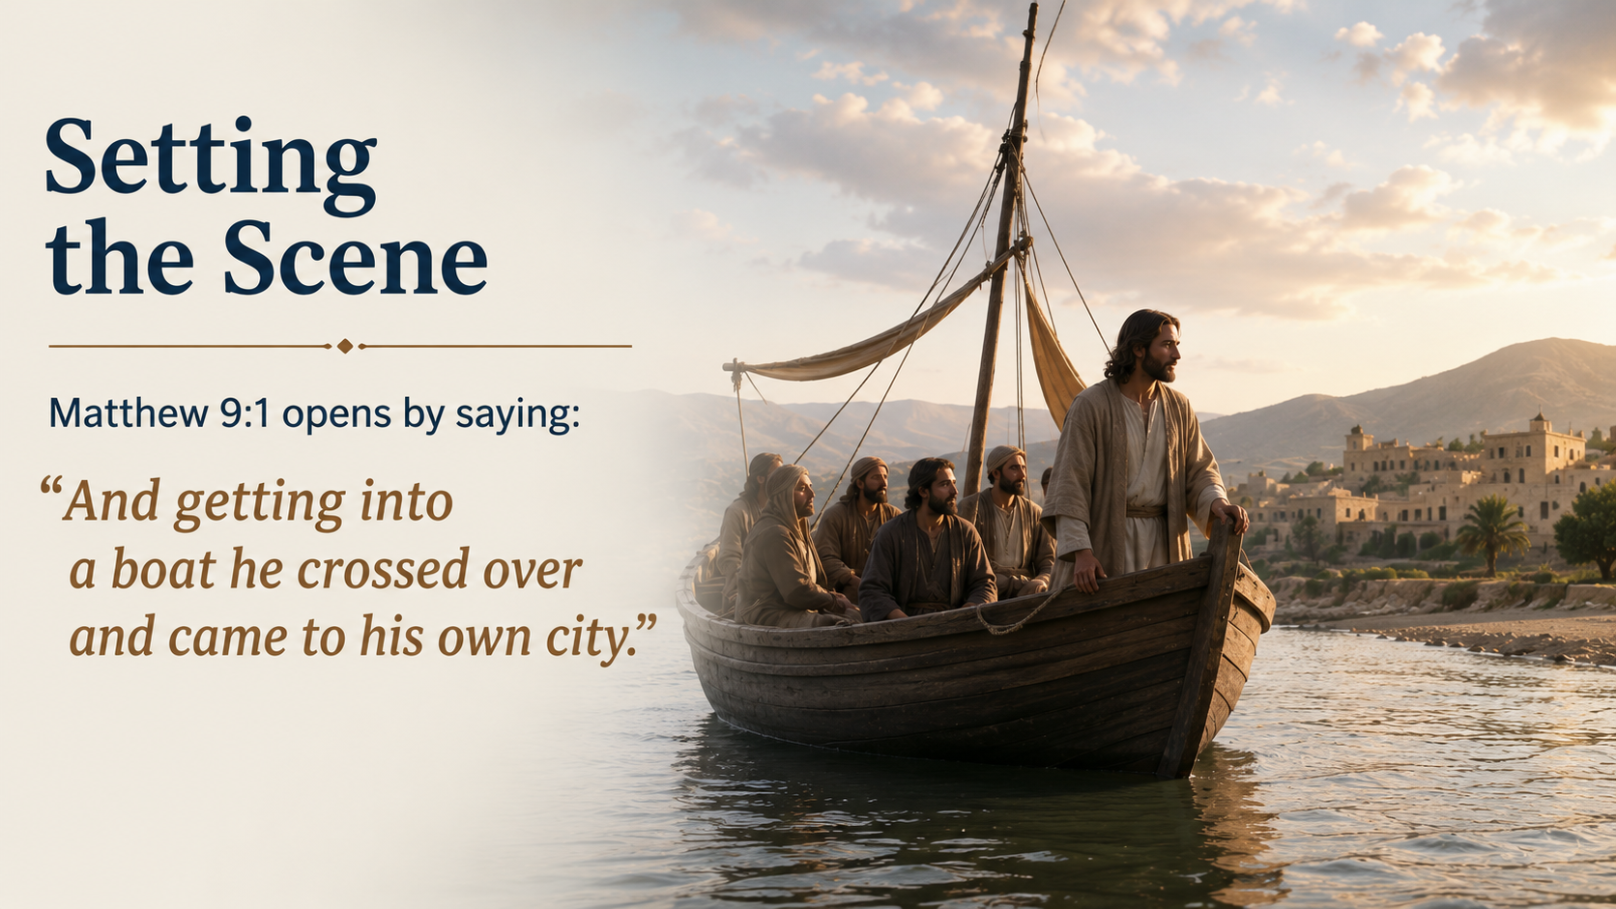
Notes:
(READ THE SLIDE FIRST) This connects directly to what just happened in Matthew 8:28–34. Jesus had crossed to the other side of the Sea of Galilee, delivered two demon-oppressed men, and then the town begged Him to leave.
So, Jesus leaves. No argument, no comment, just gone…
That’s kinda crazy...

Slide 14
Notes:
The people in the region of the Gadarenes saw His authority, but they didn’t want His presence. They valued their comfort, economy, and control more than the freedom He brought.
Now, Jesus crosses back to “his own city,” which likely refers to Capernaum, the base of His Galilean ministry.

Slide 15
Notes:
Matthew is continuing to show us the authority of the King.
His authority over disease, over nature, and over demons.
And now, in Matthew 9:1–8, Matthew brings us to the deepest authority of all:
Jesus has the authority to offer divine forgiveness of sins.

Slide 16
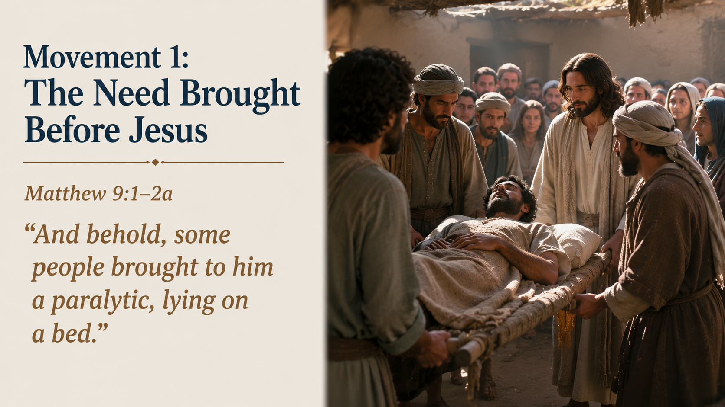
Notes:
(READ THE SLIDE FIRST – 2a) The first thing we see is a man who can’t bring himself to Jesus.
He’s paralyzed, dependent, and helpless.
He can’t walk to Jesus.
He can’t press through the crowd.
He can’t fix his own condition.
And others have to carry him.

Slide 17
Notes:
This man’s physical condition becomes a visible picture of a much deeper spiritual reality.
Sin leaves us helpless before God.
We may not feel helpless.
We may not look helpless.
We may still be religious, successful, respected, moral, and active.

Slide 18
Notes:
But spiritually, apart from Christ, we can’t heal ourselves. We can’t cleanse ourselves. We can’t forgive ourselves. We can’t stand ourselves upright before God.
This man comes to Jesus on a bed.
Not offering anything other than brokenness.
He’s simply carried to the One who heals.

Slide 19
Notes:
Then Matthew says: “And when Jesus saw their faith…”
That’s important. Jesus recognizes their faith.
Faith isn’t only an internal idea. It becomes visible through action. These people believed enough to bring this man to Jesus. They believed that if they could just get him before Christ, Jesus could do what no one else could do.

Slide 20
Notes:
Faith brought helplessness to the one who could help.
That’s what real faith does.
It doesn’t pretend to be strong.
It doesn’t put on make-up to cover things up.
It doesn’t negotiate terms.
Faith brings the helpless sinner to the only Savior.

Slide 21
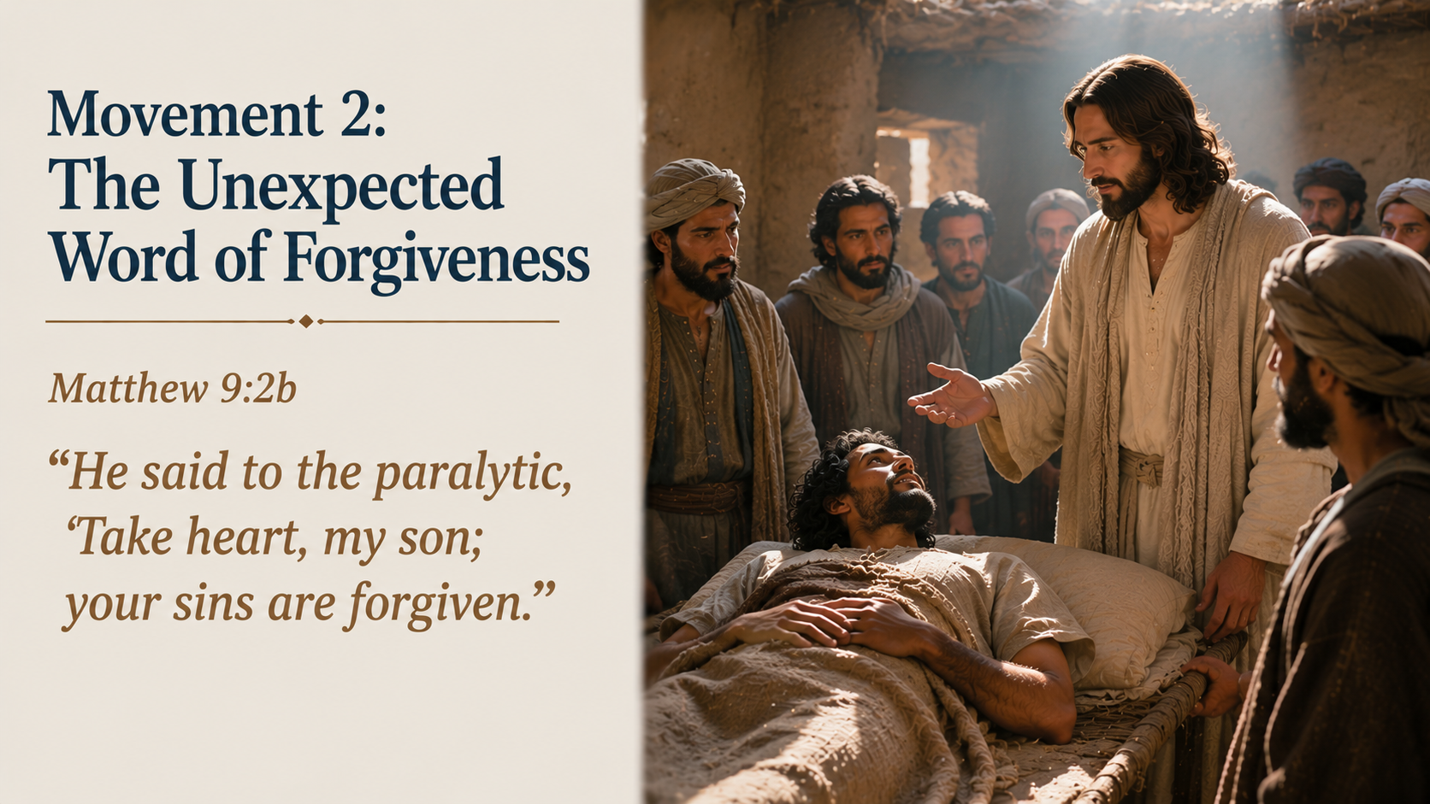
Notes:
(READ THE SLIDE FIRST) This is the shocking turn in the passage.
Everyone likely expects Jesus to say, “Be healed.”
But He doesn’t. He says: “Take heart, my son; your sins are forgiven.”
Jesus goes deeper than the visible problem.
The obvious issue is paralysis. Everyone saw that...
But, the deeper issue is sin.

Slide 22
Notes:
This doesn’t mean that this man’s paralysis was caused by a specific sin. The text doesn’t say that. We need to be careful there. Jesus isn’t saying, “You’re paralyzed because you sinned, and so I forgive those sins so now you can walk.”
But, He is showing that the man’s greatest need isn’t physical restoration.
His greatest need is spiritual restoration with God.

Slide 23
Notes:
That’s why this statement is so powerful.
Jesus doesn’t begin with the obvious physical problem.
He begins with the hidden internal one.
He says, “Take heart.” Why?
Because forgiveness is greater than mobility.
A healed body with unforgiven sin is still in danger.
But a forgiven sinner, even with a broken body, has received the greater mercy.

Slide 24
Notes:
Then Jesus calls him: “my son”
That’s tenderness. Compassionate, intimate, and merciful.
Jesus doesn’t speak to him like he’s a case study.
He doesn’t speak to him like he’s a burden.
He doesn’t speak to him like he’s an interruption.
He speaks to him like he’s a son.

Slide 25
Notes:
The King with all authority isn’t cold with sinners who come to Him in faith.
He’s compassionate, and then He says: “Your sins are forgiven.”
Not “might be forgiven if you tip the scales in your favor.”
Not “can be forgiven if you prove yourself worthy enough.”
Not “will be forgiven after you do all these things.”
Forgiven, period. Jesus speaks with absolute divine authority.

Slide 26
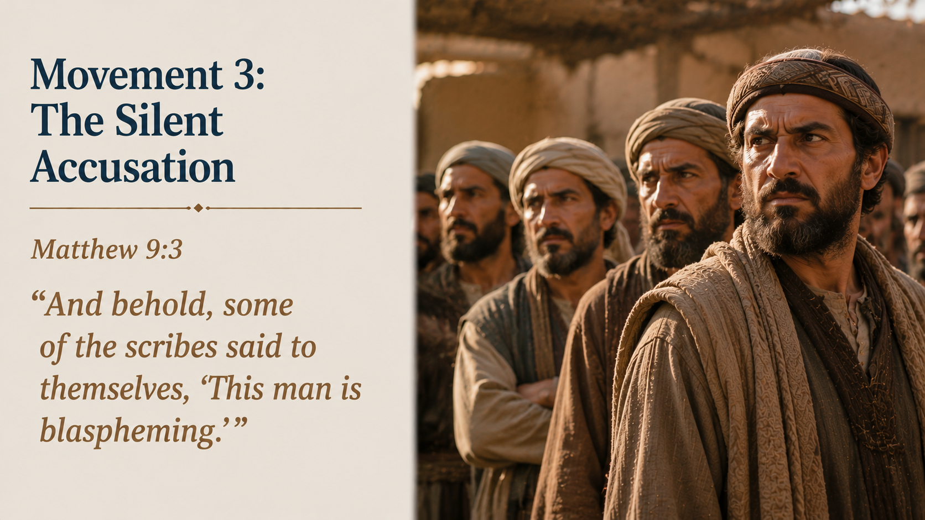
Notes:
(READ THE SLIDE FIRST) Now the conflict begins.
The scribes understand the claim Jesus is making.
In one sense, their theology is correct. Only God can forgive sins.
If someone sins against God, then only God has the authority to release that guilt.
So, when Jesus says, “Your sins are forgiven,” He isn’t merely offering comfort or showing mercy and grace. He’s making a divine claim.

Slide 27
Notes:
The scribes know it. That’s why they say:
“This man is blaspheming.”
Blasphemy isn’t a small accusation in their culture.
They believe Jesus is dishonoring God by claiming authority that belongs only to God.

Slide 28
Notes:
But their problem isn’t that they take forgiveness too seriously.
Their problem is that they don’t recognize who’s standing right in front of them.
They have the right categorical claim: Only God can forgive sins.
But they draw the wrong conclusion.

Slide 29
Notes:
They say, “Jesus must be blaspheming.” (because He isn’t God)
The right conclusion should be:
“If Jesus truly has the authority to forgive sins, then God Himself has come near.”

Slide 30
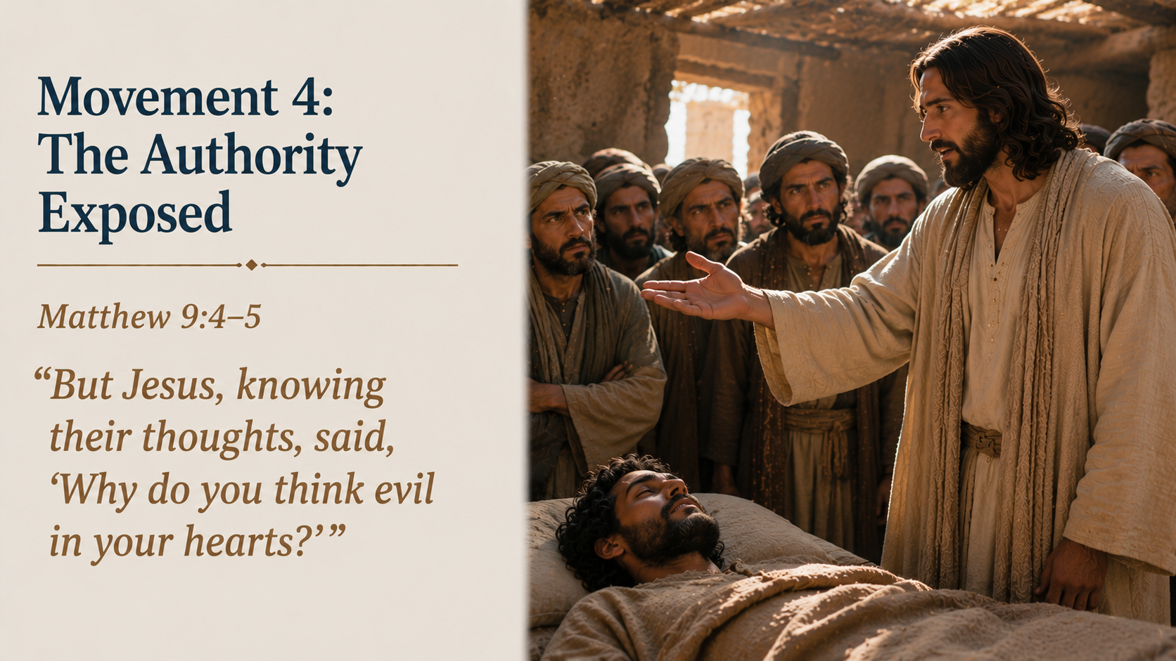
Notes:
(READ THE SLIDE FIRST) This is another display of His authority.
Jesus knows their thoughts.
They haven’t spoken out loud for all to hear.
They haven’t confronted Him publicly yet.
But Jesus reads the room beneath the surface.
He sees their hearts.

Slide 31
Notes:
Then He asks: “Why do you think evil in your hearts?”
That’s a strong question.
Their objection probably seemed righteous to them. They likely thought they were defending God’s honor.
But Jesus exposes the heart beneath their resistance.
Their problem isn’t a theological issue.
Their problem is unbelief.

Slide 32
Notes:
Then Jesus asks in verse 5:
“For which is easier, to say, ‘Your sins are forgiven,’ or to say, ‘Rise and walk’?”
That question is brilliant.
In one sense, it’s way easier to say, “Your sins are forgiven,” because no one can visibly verify it in the moment. You can’t visibly measure whether they’re forgiven or not…

Slide 33
Notes:
But to say, “Rise and walk” to a paralyzed man is immediately testable.
If nothing happens, everyone knows the claim is empty.
So, Jesus sets up the visible miracle (what happens next) as proof of the invisible forgiveness of sin (what had just happened).

Slide 34
Notes:
He’s about to heal the man’s body to prove He has the full authority to forgive the man’s sins.
The healing isn’t the main point.
The healing is the evidence of the main point – forgiveness of sins... Divine forgiveness…

Slide 35
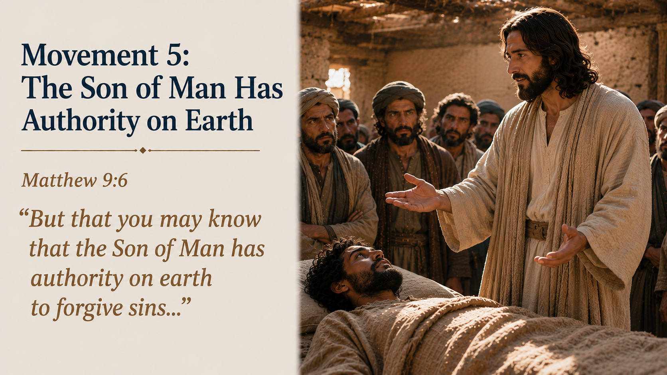
Notes:
(READ THE SLIDE FIRST) This is the center of the passage.
Jesus identifies Himself as: “the Son of Man”
That title matters greatly.
It can emphasize His humanity (identifying with us), but it also reaches back to Daniel 7, where “one like a son of man” receives dominion, glory, and a kingdom from the Ancient of Days.

Slide 36
Notes:
So, Jesus isn’t lowering the claim. He’s heightening it.
He is the Son of Man with divine authority.
And notice the phrase: “on earth”
That’s important also.
Jesus isn’t saying forgiveness is a distant heavenly possibility.
He has the authority on earth to forgive sins.

Slide 37
Notes:
Right here. Right now.
In the middle of human brokenness.
In a crowded house. In front of critics.
Before the cross had even happened historically, Jesus stands as the foundation of all forgiveness.
Jesus has the absolute authority to forgive.

Slide 38
Notes:
Then He turns to the paralytic and says: “Rise, pick up your bed and go home.”
This command is immediate and direct.
No delay, it’s immediate.
No struggle, it’s effortless.
No partial improvement, total restoration.
The same authority that forgives sins now commands a paralyzed body.
And the body obeys.

Slide 39
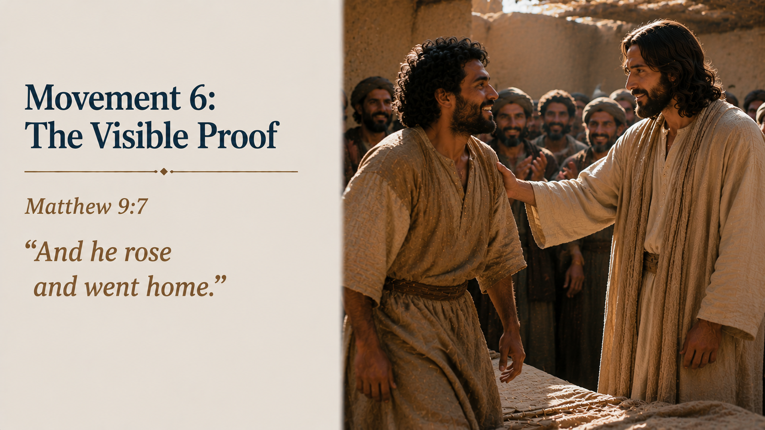
Notes:
(READ THE SLIDE FIRST) That is beautifully simple.
Jesus speaks. The man obeys.
The bed that once carried him is now carried by him.
His condition has completely changed.
His shame has been dealt with.
His sins have been forgiven.
His body has been restored.
His life has been publicly transformed.

Slide 40
Notes:
But remember, the healing points beyond just a healing.
Jesus didn’t heal the man merely to show compassion, though He is compassionate.
He healed him to prove His authority over sin.
The visible miracle confirms the invisible forgiveness.
The man walking home is a living sermon:
The Son of Man has authority on earth that only God possesses.

Slide 41
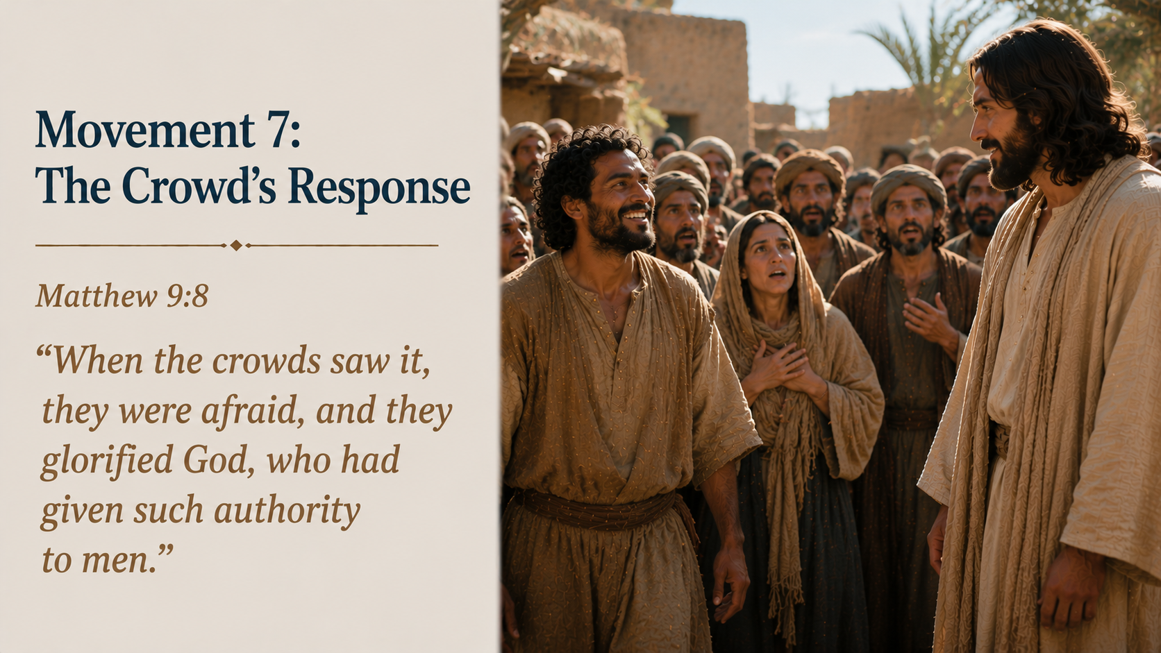
Notes:
(READ THE SLIDE FIRST) The crowd responds with fear and praise.
That combination is right.
They’re not merely impressed. They’re shaken.
They’ve seen something that can’t be explained away. A paralyzed man walked home. But even more than that, Jesus claimed and demonstrated divine authority to forgive sins.

Slide 42
Notes:
Matthew says they glorified God, and that’s also the right response to the authority of Jesus.
Not a casual interest.
Not a religious critique.
Not distant curiosity.
But praise and worship.

Slide 43
Notes:
Notice that Matthew’s wording here is interesting:
“who had given such authority to men.”
The crowd sees something extraordinary, but they don’t fully understand who Jesus is yet...
They know God is at work.
They know His authority has been displayed.
They know something divine has broken into the ordinary.

Slide 44
Notes:
Perhaps they thought that Jesus was just a man that God zapped with powers over the physical and spiritual realms...
But this isn’t merely authority given to a man.
This is the long-awaited Messiah, the promised King. God in the flesh… the 2nd member of the Trinity!

Slide 45
Notes:
Jesus is doing what only God can do. And Jesus claims in many ways that He and the Father are one... He is God – which is what ultimately leads Him to the cross.
And in this passage here, like God, He forgives sins.

Slide 46

Notes:
7 movements and a summary…

Slide 47


Slide 48
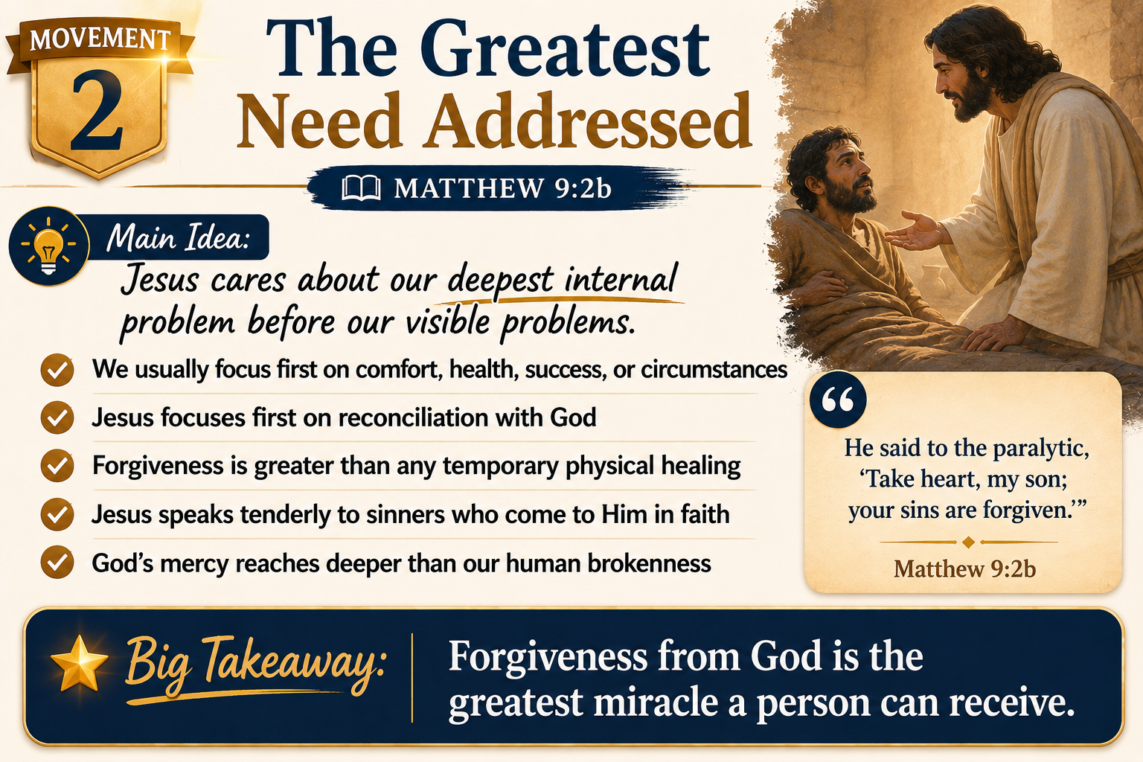

Slide 49
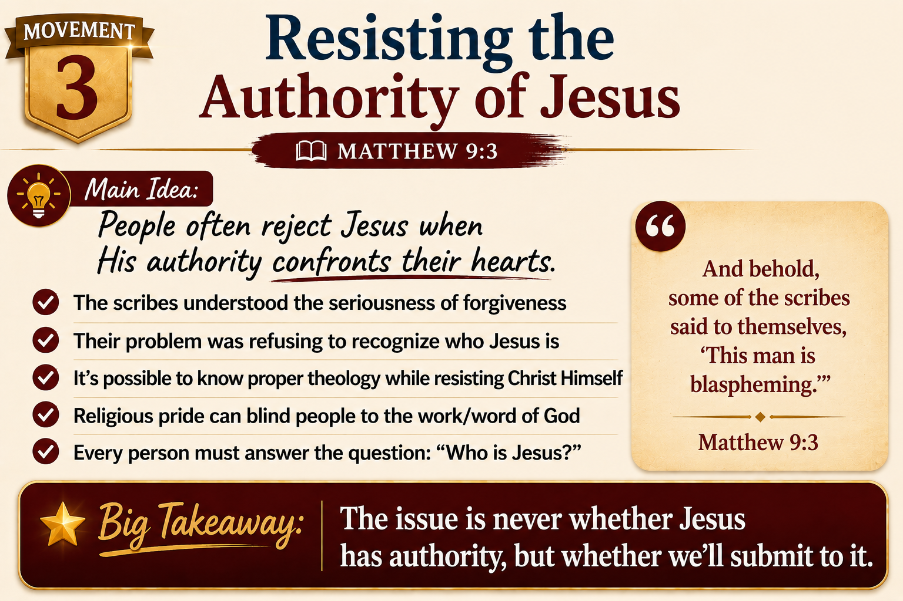

Slide 50


Slide 51
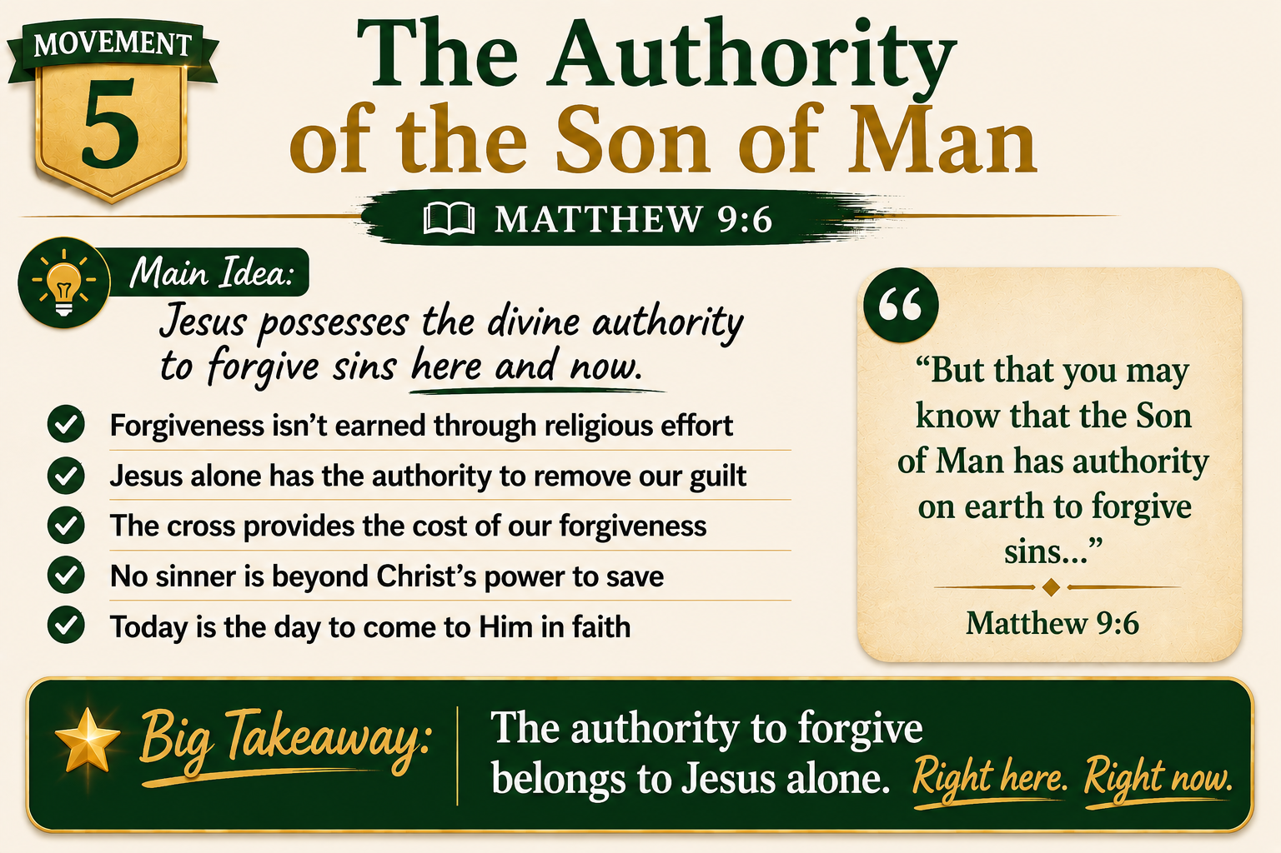

Slide 52
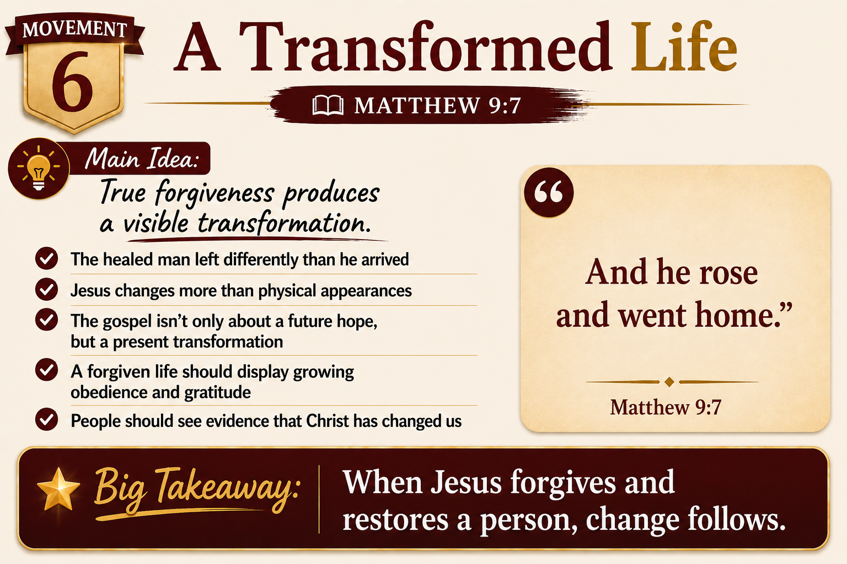

Slide 53


Slide 54
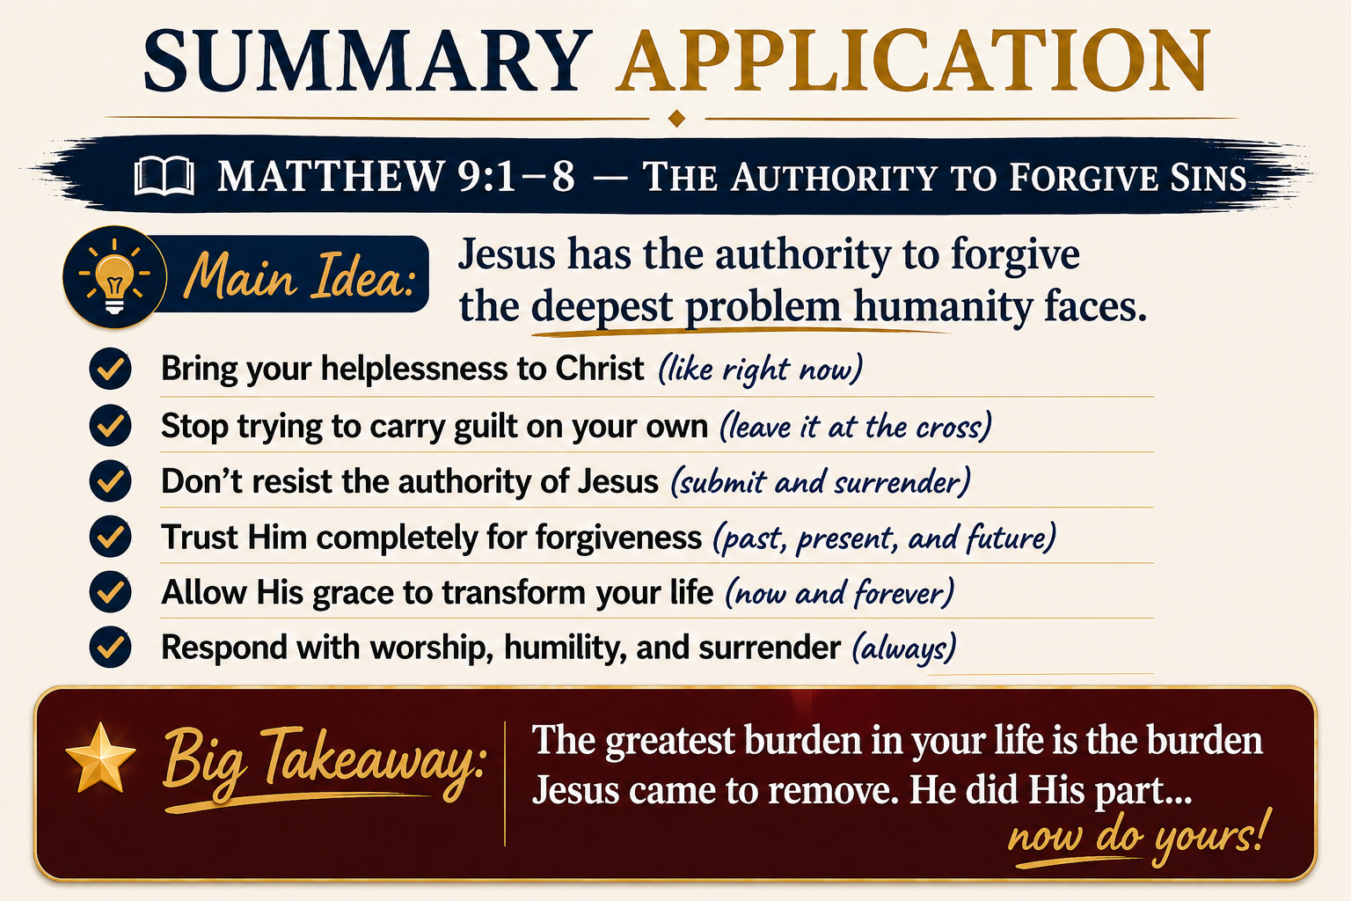

Slide 55
Notes:
For far too long, that woman carried the weight of one terrible wrong done against her family.
One man’s crime shattered her childhood, stole years of joy, and left scars that lasted decades.

Slide 56
Notes:
And after years of carrying that burden, she chose to release it; she chose to forgive.
That’s what made the story so powerful.
Not because the crime was small.
Not because justice didn’t matter.
Not because the pain disappeared.
But because forgiveness feels impossible when the offense is so deep.

Slide 57
Notes:
And that’s where Matthew 9 suddenly turns the spotlight onto us.
Because it’s easy to stand outside a story like this and think about someone else’s guilt.
Someone else’s failure.
Someone else’s wrongdoing.
Someone else’s need for mercy.

Slide 58
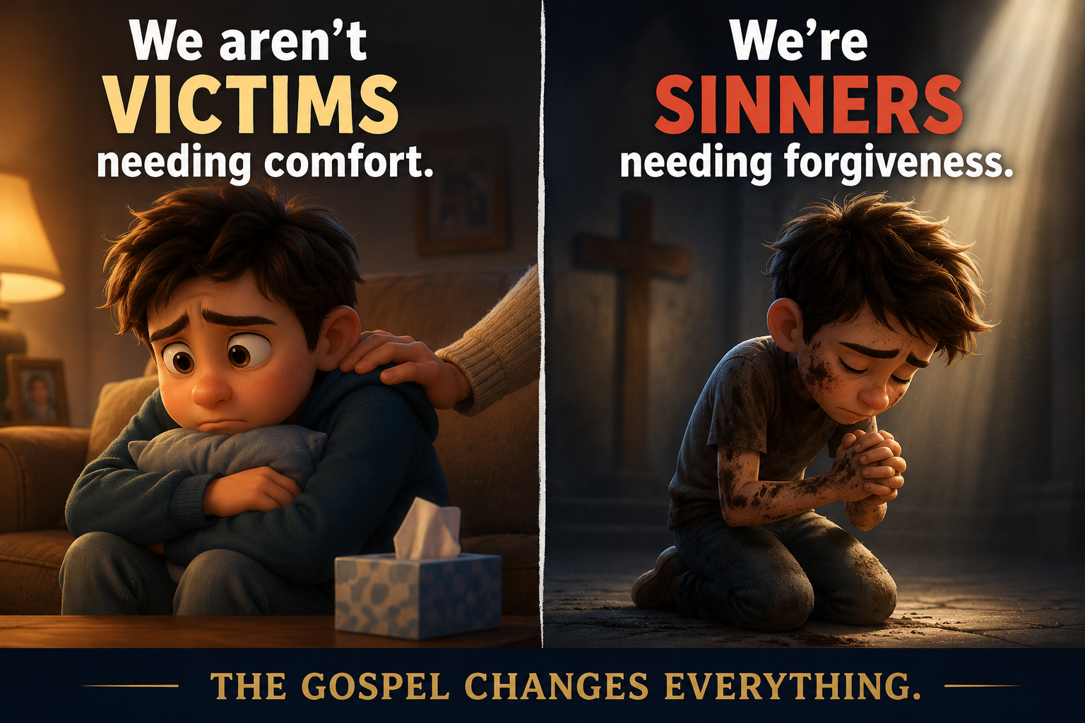
Notes:
But Scripture constantly pulls us back to a much harder truth:
We aren’t victims needing comfort.
We’re sinners needing forgiveness.
The paralytic in Matthew 9 wasn’t just physically broken.
He was spiritually broken. And so are we.

Slide 59
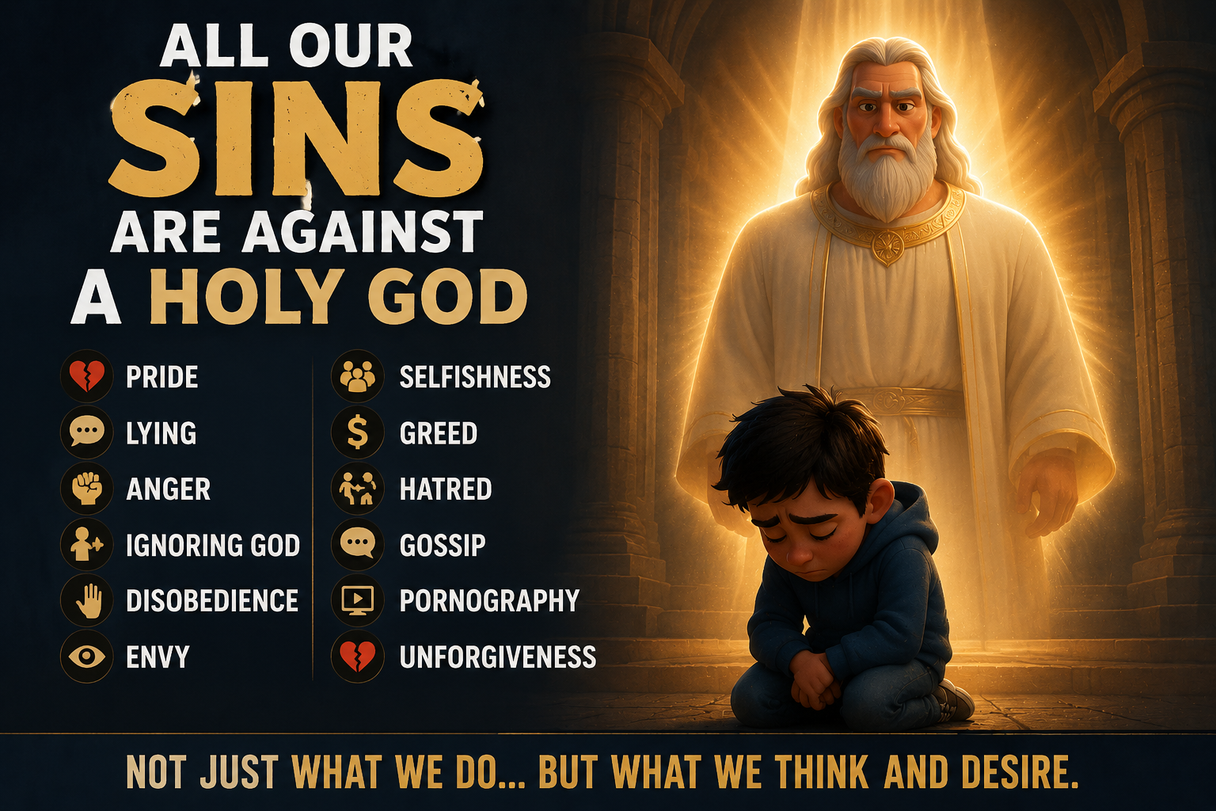
Notes:
The Bible says our sin isn’t merely against people ultimately, but against God Himself.
Every lie. Every proud thought. Every selfish motive.
Every lustful glance. Every act of hatred. Every moment of rebellion.
Every failure to love God fully. Every failure to love others rightly.
Not one sin. Thousands. Millions. Billions...

Slide 60
Notes:
And unlike the opening story, our sin isn’t just against another sinner.
It’s against a holy God. That’s what makes Matthew 9 so staggering.
Because Jesus doesn’t merely offer emotional relief.
He doesn’t just say, “It’s okay.” It’s not...
He doesn’t ignore justice. He faces that Himself for us...
So, He can say, “Your sins are forgiven.”
And He says it with authority. Immediate and absolute…

Slide 61
Notes:
The woman in the opening story let go of the pain of another person’s wrongdoing so bitterness wouldn’t consume her life.
But Jesus does infinitely more than that.

Slide 62
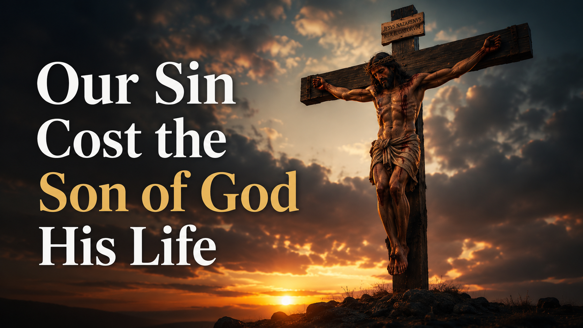
Notes:
Jesus absorbs the judgment our sin deserves upon Himself at the cross so we can be reconciled to God.
Human forgiveness is costly. Divine forgiveness cost the Son of God His life.

Slide 63
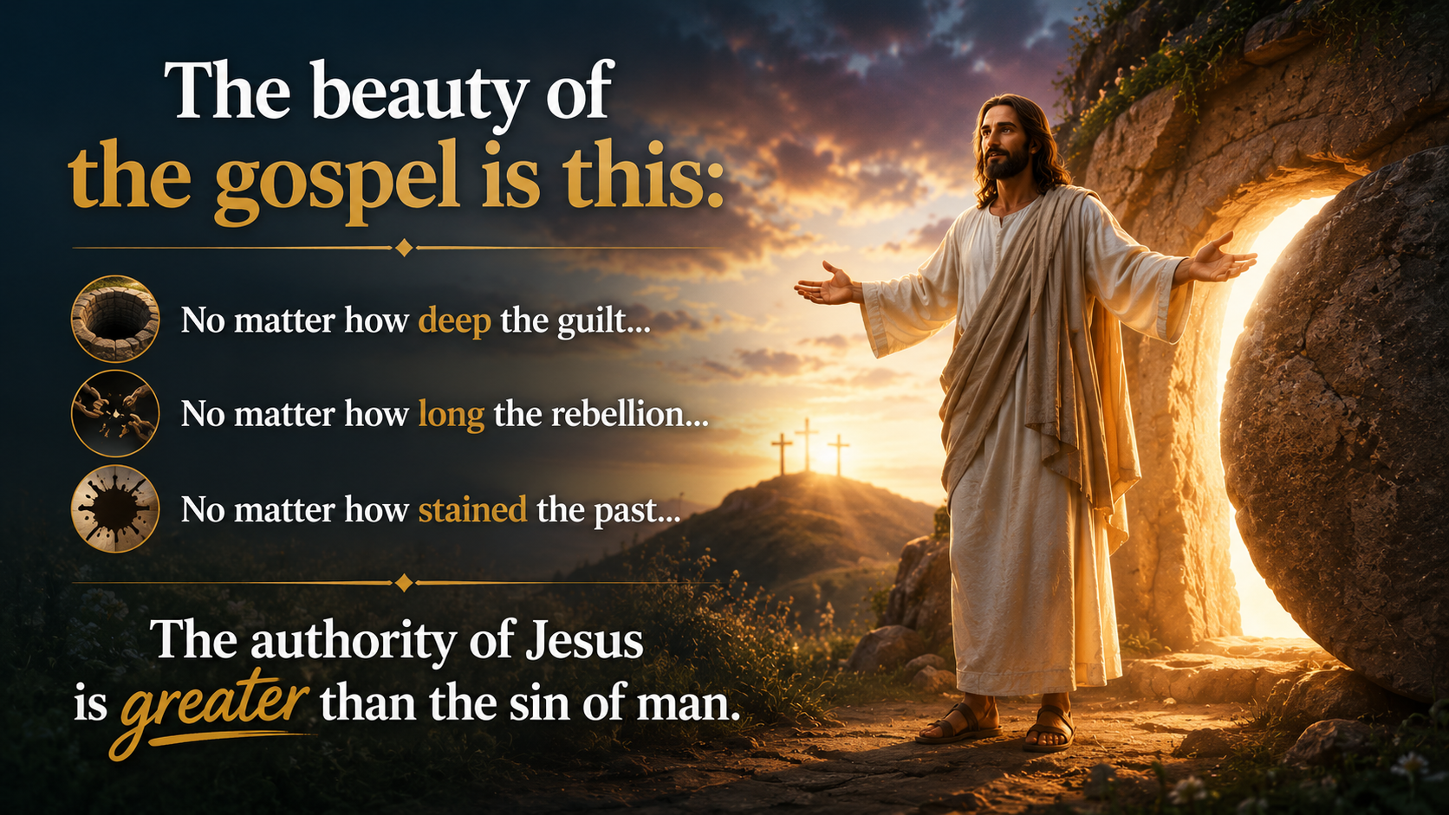
Notes:
(READ THE SLIDE FIRST) That’s the hope of Matthew 9.
The Son of Man has Divine authority to forgive you... So, come to Him and let Him forgive you...
His authority is always there... Forgiveness is always available… the choice is yours! What will you choose?

Slide 64
Notes:
Heavenly Father, we thank You for the forgiveness found in Christ alone.
Help us leave here changed, no longer carrying guilt and shame, but walking in the freedom You give.
Teach us to worship You with humble and surrendered hearts this week.
And may the authority of Jesus shape the way we live every day.
In Jesus’ name, amen.

