Slide 1
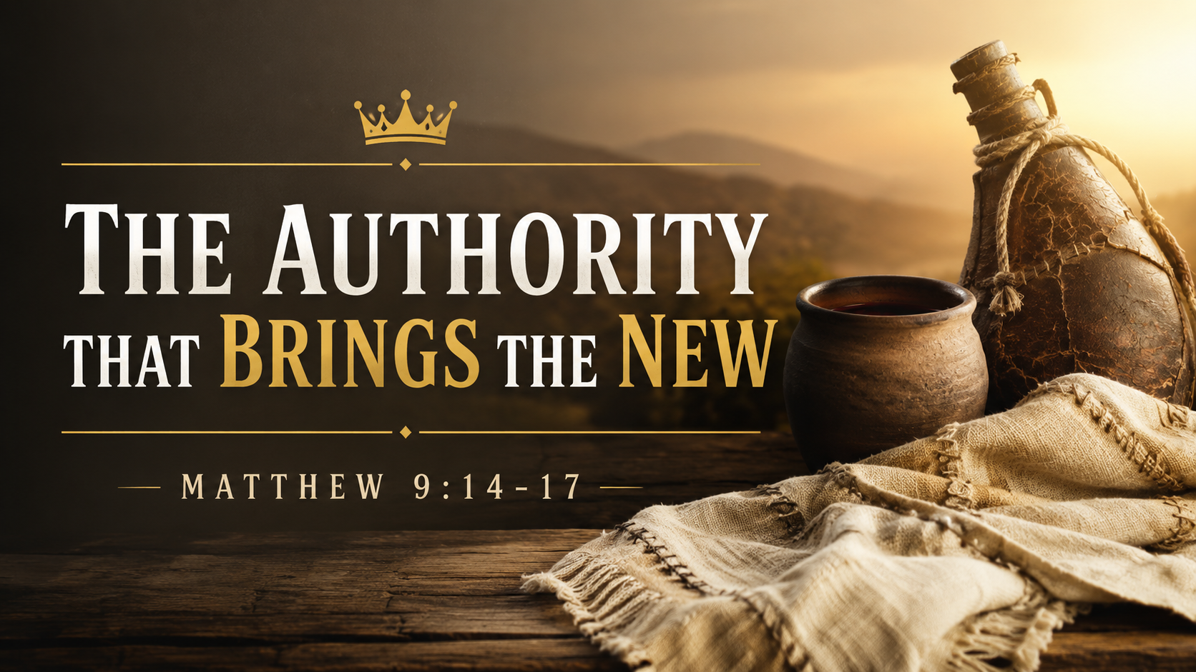

Slide 2
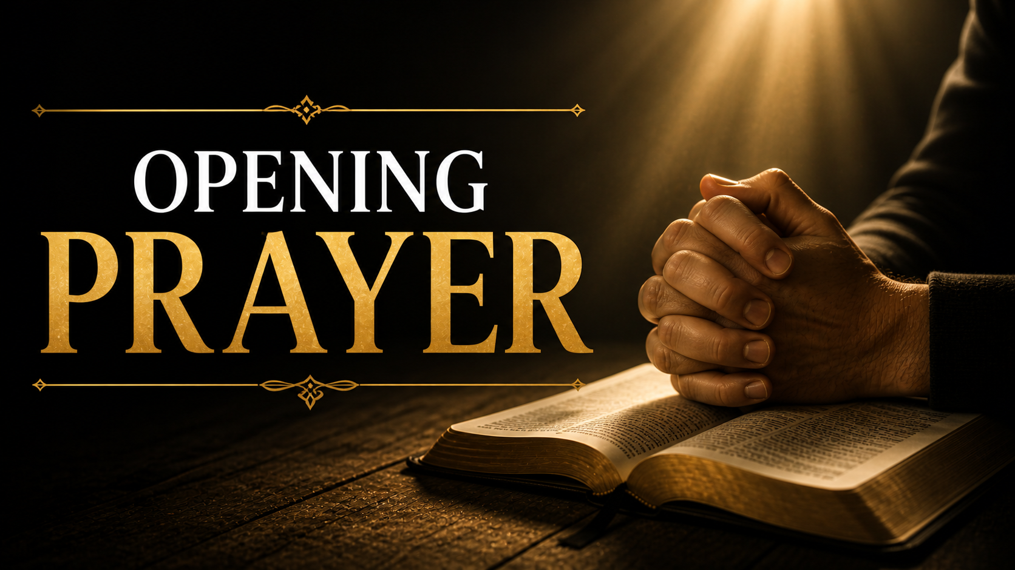

Slide 3

Notes:
A small family-owned business had been operating the same way for the last fifty years.
The employees knew exactly where everything belonged. They knew which forms to fill out, which doors to use, which procedures to follow, and which traditions everyone was expected to keep. Some of those practices made perfect sense. Others existed simply because they were always done that way.

Slide 4

Notes:
Then one day a new manager arrived. The owner himself had sent him.
At first everyone was excited. They assumed he would fit into the existing system and preserve everything exactly as it was.
After all, if the owner trusted him enough to give him all this authority, surely he would do what was best for everyone…

Slide 5

Notes:
Instead, he started changing things.
Old paperwork disappeared. New systems were introduced. Departments were reorganized. Meetings looked different. Priorities shifted.
Some employees embraced the changes because they understood what the manager was trying to accomplish.

Slide 6
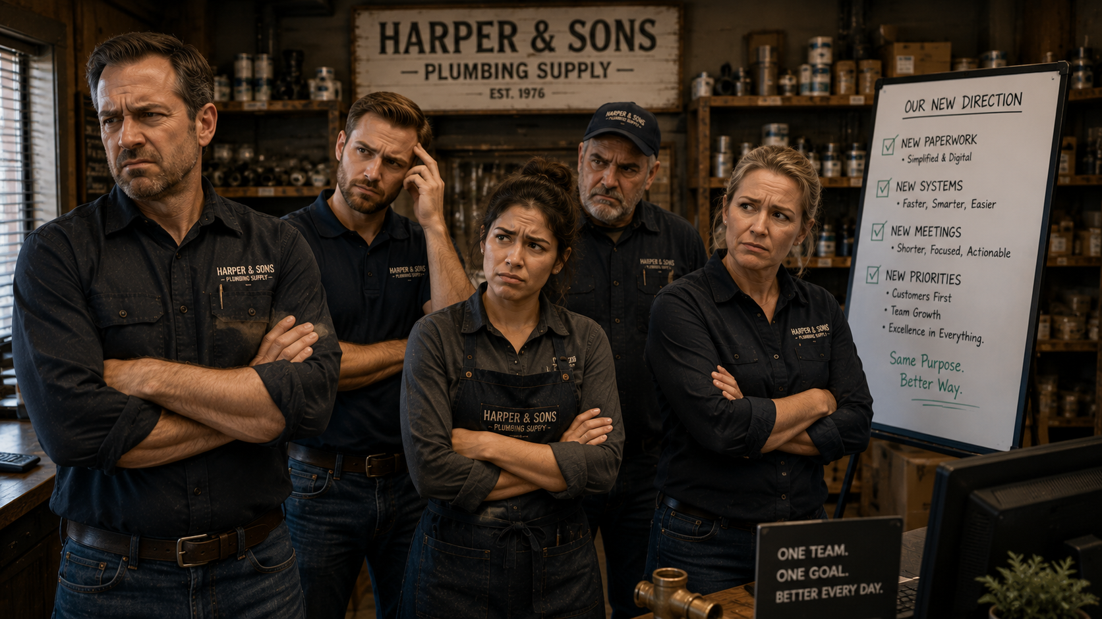
Notes:
Others became frustrated.
They weren't asking whether the changes worked.
They weren't asking whether the owner had authorized them.
Their question was much simpler:
"Why isn't he doing things the way we've always done them?"

Slide 7
Notes:
The problem wasn't really the new procedures.
The problem was that they loved the old system more than they trusted the authority of this new manager, who was sent by the owner.

Slide 8

Notes:
And that's often how people respond when God begins doing something new.
We become comfortable with routines, traditions, and expectations. We assume God should work within the structures we've built.
Then Jesus arrives and starts rearranging everything.

Slide 9
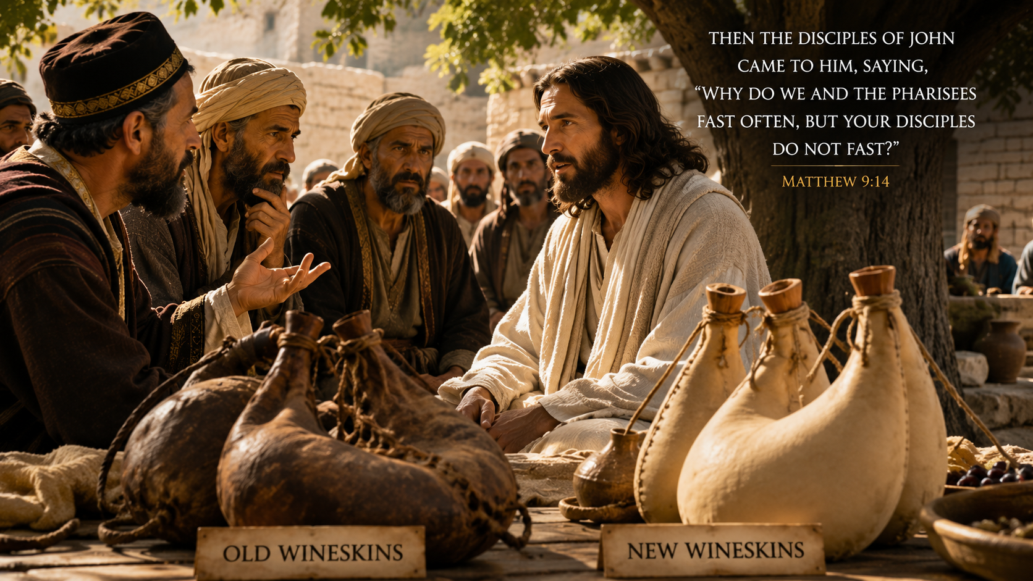
Notes:
That's exactly the tension we find in Matthew 9.
A question is asked about fasting.
But beneath the question lies a much bigger issue:
What happens when the King arrives and brings something new that cannot be contained by the old?

Slide 10
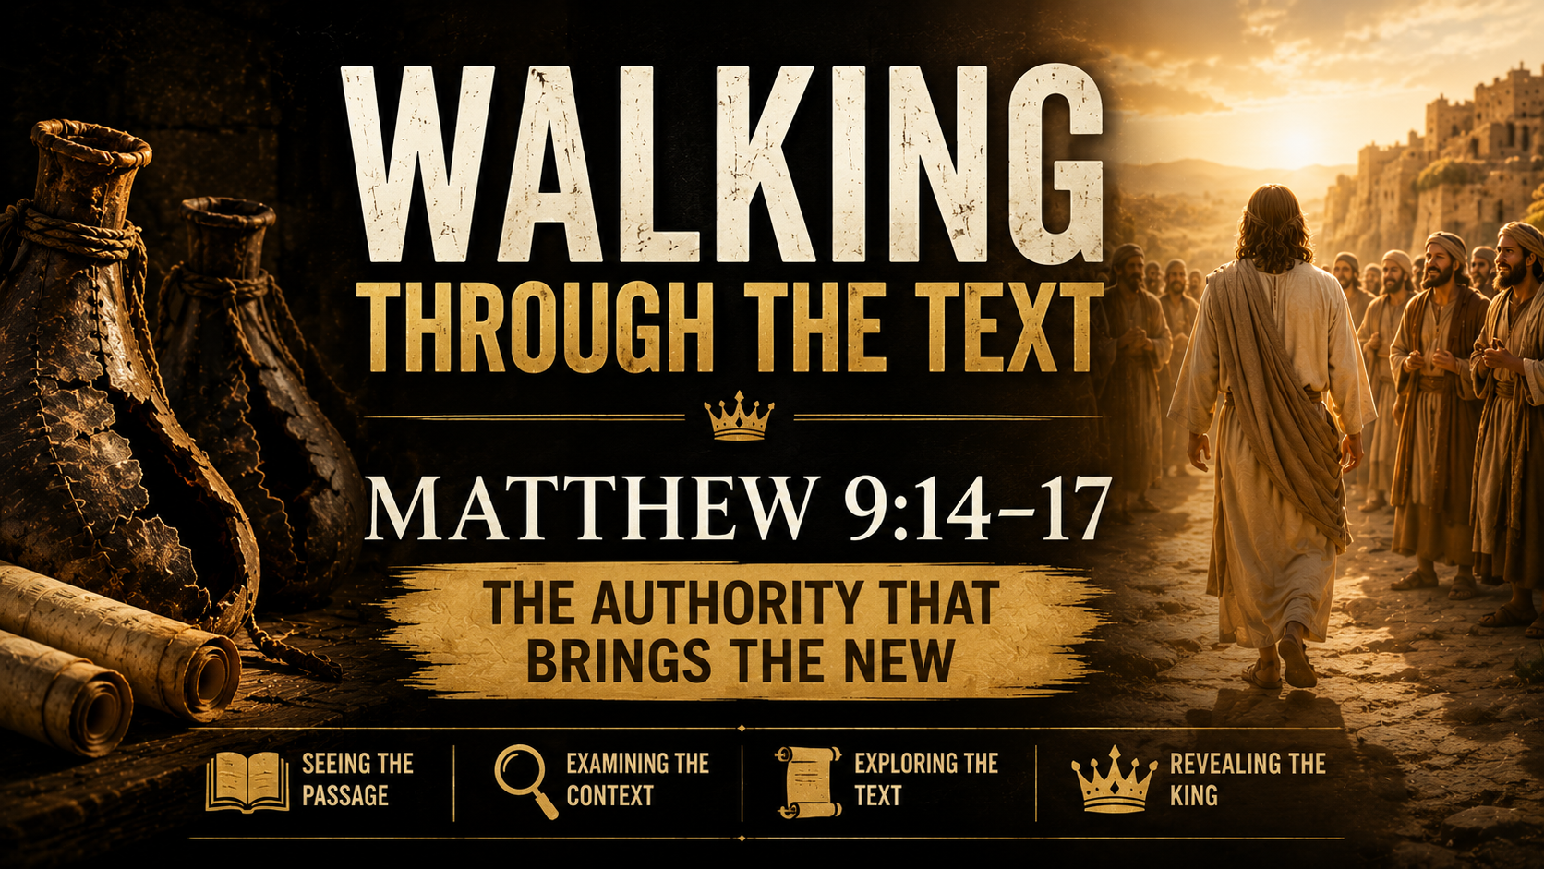

Slide 11
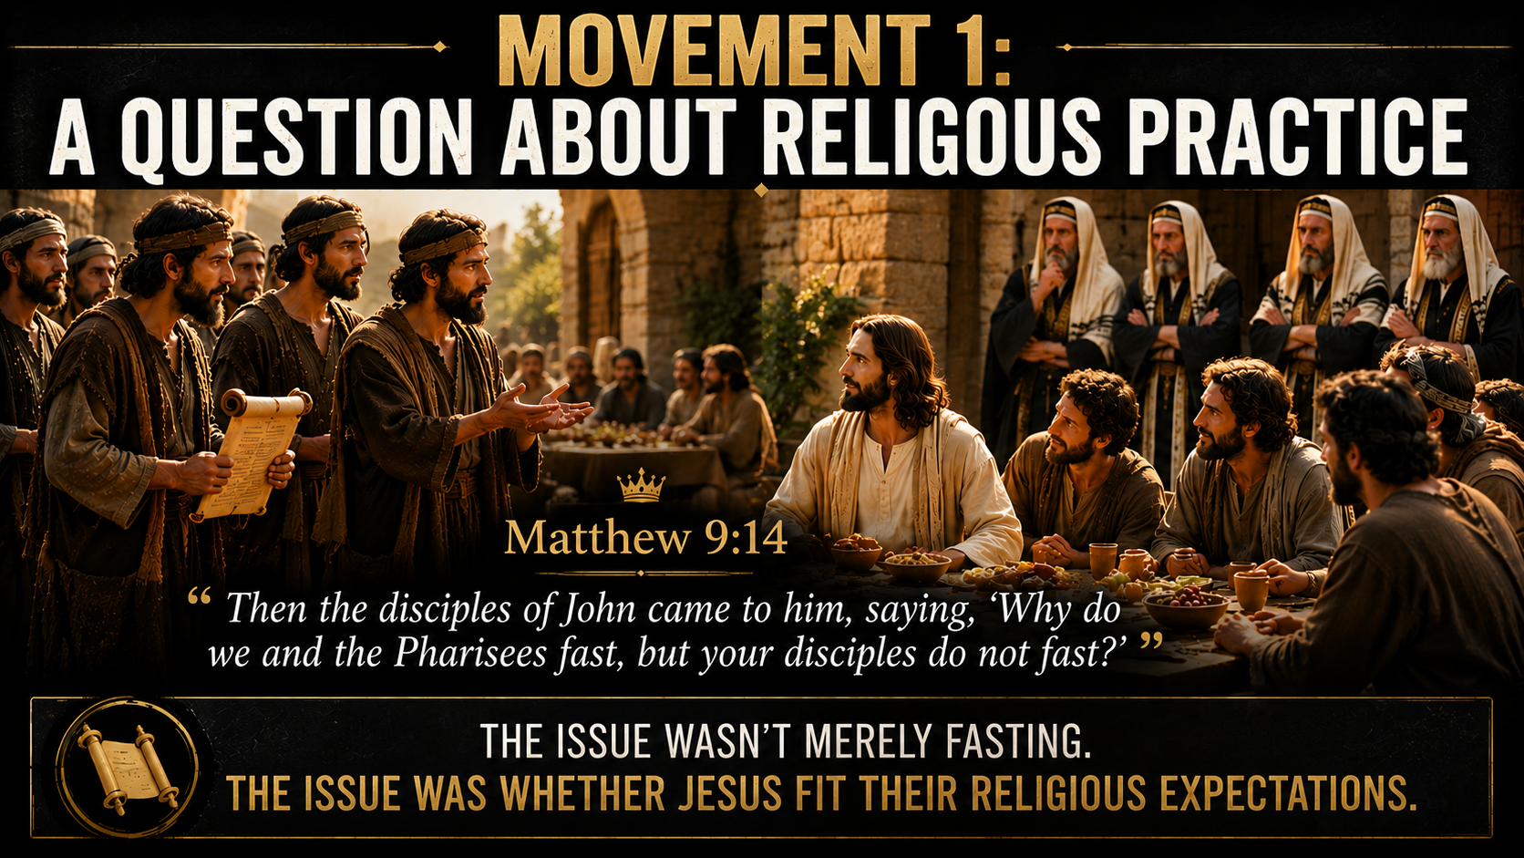
Notes:
(READ THE SLIDE FIRST) This scene follows directly after Jesus has called Matthew, the tax collector, and then shared a meal with tax collectors and sinners. That context matters. Jesus has just demonstrated that His authority reaches the unworthy, the rejected, and the spiritually sick. He hasn’t withdrawn from sinners. He has moved toward them. Plus, the Pharisees challenged that practice, and they are brought into this one as well.

Slide 12
Notes:
This time, the question comes from the disciples of John the Baptist. They ask why they and the Pharisees fast, but Jesus’ disciples do not.
This wasn’t a random question. Fasting was a serious religious practice in first-century Judaism. In the Old Testament, only one fast was commanded annually under the Law, connected to the Day of Atonement. But by Jesus’ day, additional fasting had become a regular expression of religious devotion, repentance, mourning, and spiritual seriousness.

Slide 13
Notes:
The Pharisees were known for fasting regularly. Luke 18:12 shows the Pharisee saying, “I fast twice a week.” John’s disciples also likely practiced fasting because John’s ministry carried a strong tone of repentance, preparation, and solemn seriousness. John came announcing that the kingdom was near and calling Israel to repent.

Slide 14
Notes:
So, the question is understandable. They’re not asking why Jesus’ disciples are immoral.
They’re asking why Jesus’ disciples don’t seem to match the expected pattern of religious seriousness.
In other words, “If You are truly from God, why don’t Your disciples look like the serious religious people we already recognize?”

Slide 15
Notes:
That’s the tension in the passage.
The issue isn’t merely fasting. The deeper issue is expectation. They have a category for devotion.
They have a category for repentance. They have a category for seriousness.
But Jesus doesn’t fit neatly into the categories they already have.

Slide 16
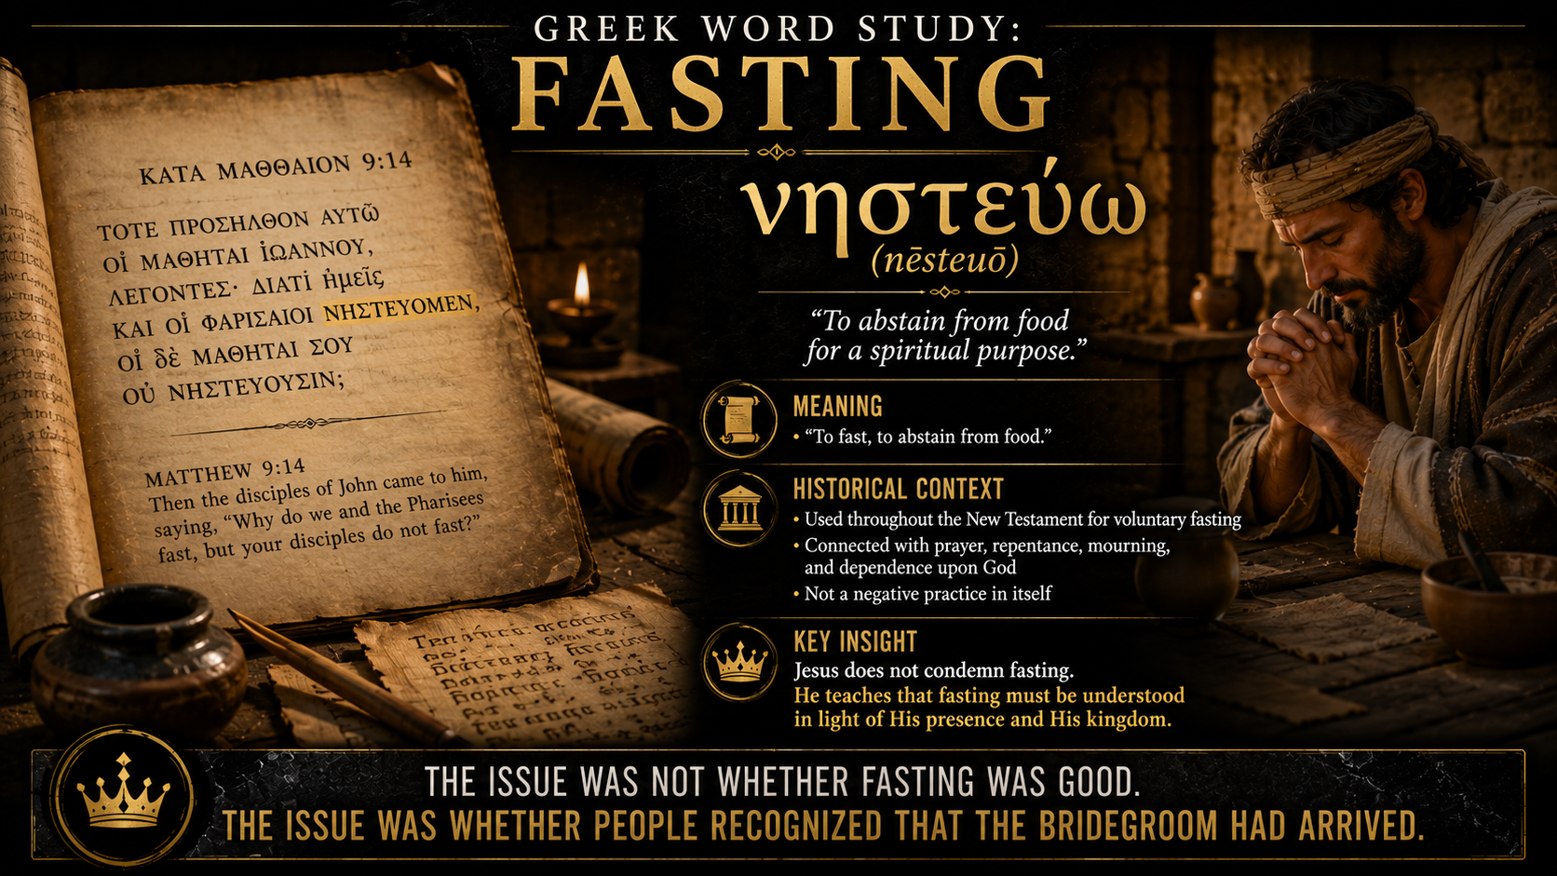
Notes:
The Greek word for fasting is νηστεύομεν (nace-tay-u-oh-mane) (GO OVER THE SLIDE)

Slide 17
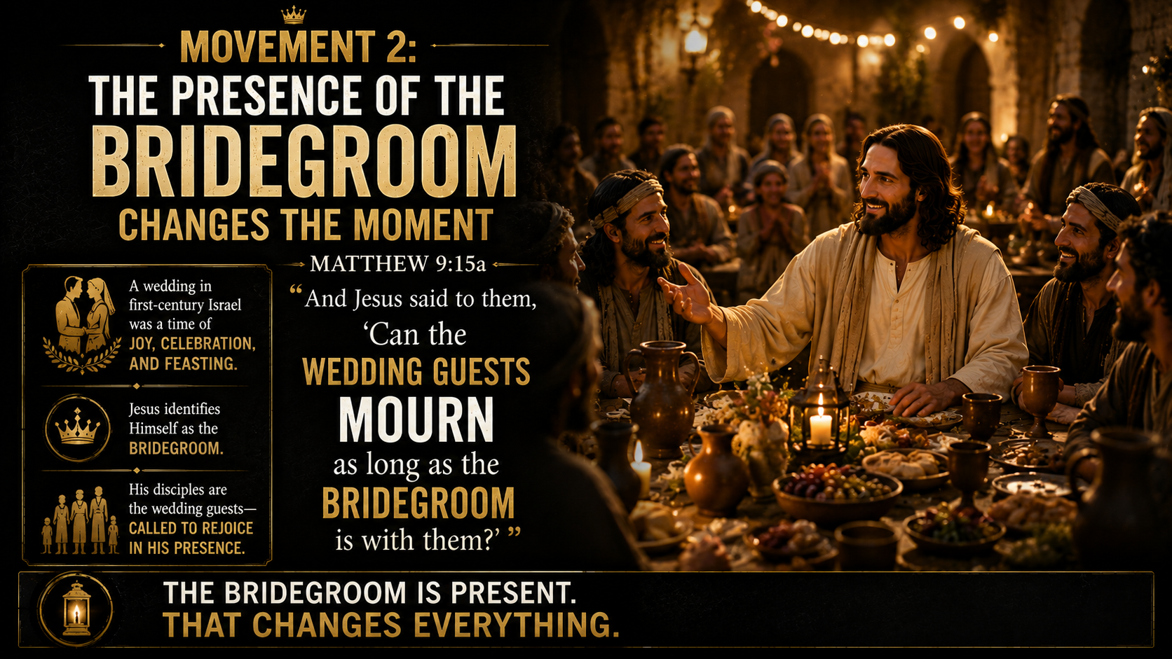
Notes:
(READ THE SLIDE FIRST – TITLE AND SCRIPTURE ONLY) Jesus answers their question with a wedding image.
This is important because Jesus doesn’t begin by arguing against fasting. He begins by identifying the moment.
A wedding wasn’t a time for mourning. It was a time for joy, celebration, feasting, and gladness. In the ancient Jewish world, wedding celebrations could last for several days. The presence of the bridegroom determined the tone of the event.

Slide 18
Notes:
So, Jesus asks a question that exposes the timing issue.
Can wedding guests mourn while the bridegroom is with them?
The implied obvious answer is no.
The phrase “wedding guests” is literally “sons of the bridechamber,” an idiom referring to the companions of the bridegroom. These are the people closest to the celebration. Their role isn’t to grieve while the bridegroom is present. Their role is to rejoice.

Slide 19
Notes:
This means Jesus isn’t saying fasting has no place. He is saying fasting doesn’t fit the moment when the Bridegroom is present.
That’s a massive claim.
In the Old Testament, God is often pictured as the husband or bridegroom of His people. Israel’s unfaithfulness is described as spiritual adultery. The prophets look forward to a day when God will restore His people in covenant faithfulness and joy.

Slide 20
Notes:
So, when Jesus describes Himself as the bridegroom, He’s doing more than making a simple illustration. He’s identifying His presence as the arrival of long-awaited covenant joy.
John the Baptist himself used this imagery in John 3:29 when he said, “The one who has the bride is the bridegroom.” John understood that his role wasn’t to be the bridegroom. He was the friend who rejoiced at the bridegroom’s voice.

Slide 21
Notes:
So Jesus’ answer is deeply theological.
His disciples aren’t fasting like mourners because the Bridegroom is with them.
The kingdom has come near. The King is present. The long-awaited One has arrived.
This doesn’t eliminate fasting forever, but it redefines the practice around Jesus Himself.

Slide 22
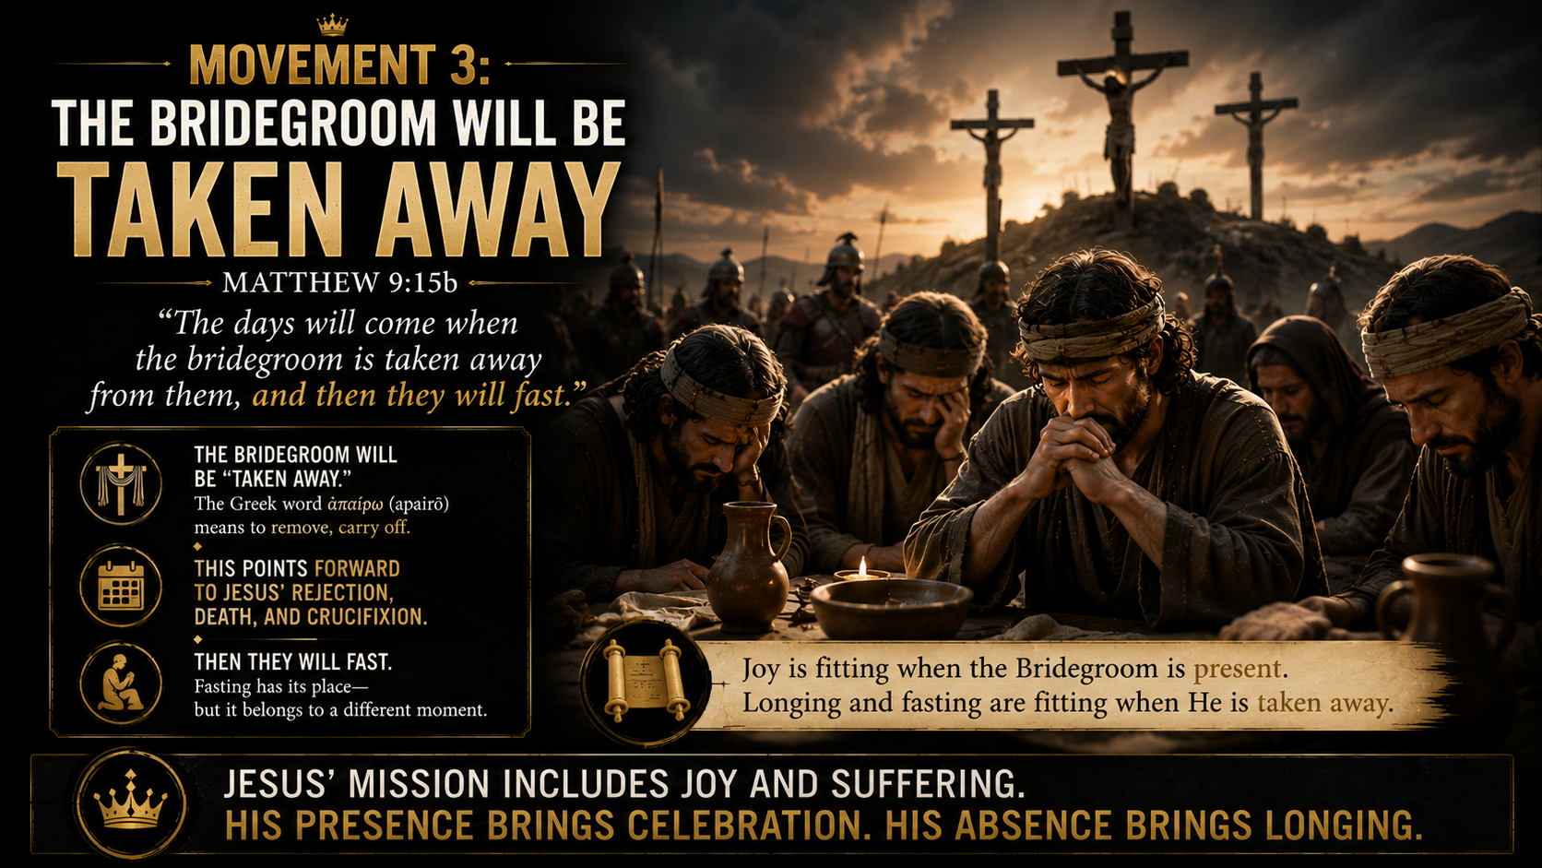
Notes:
(READ THE SLIDE FIRST – JUST THE TITLE & SCRIPTURE) Jesus then adds a sobering note.
The Bridegroom is present, but He won’t remain with them in the same way. “The days will come when the bridegroom is taken away.”
The language here is striking. Jesus doesn’t merely say He will leave. He says He will be “taken away.”

Slide 23
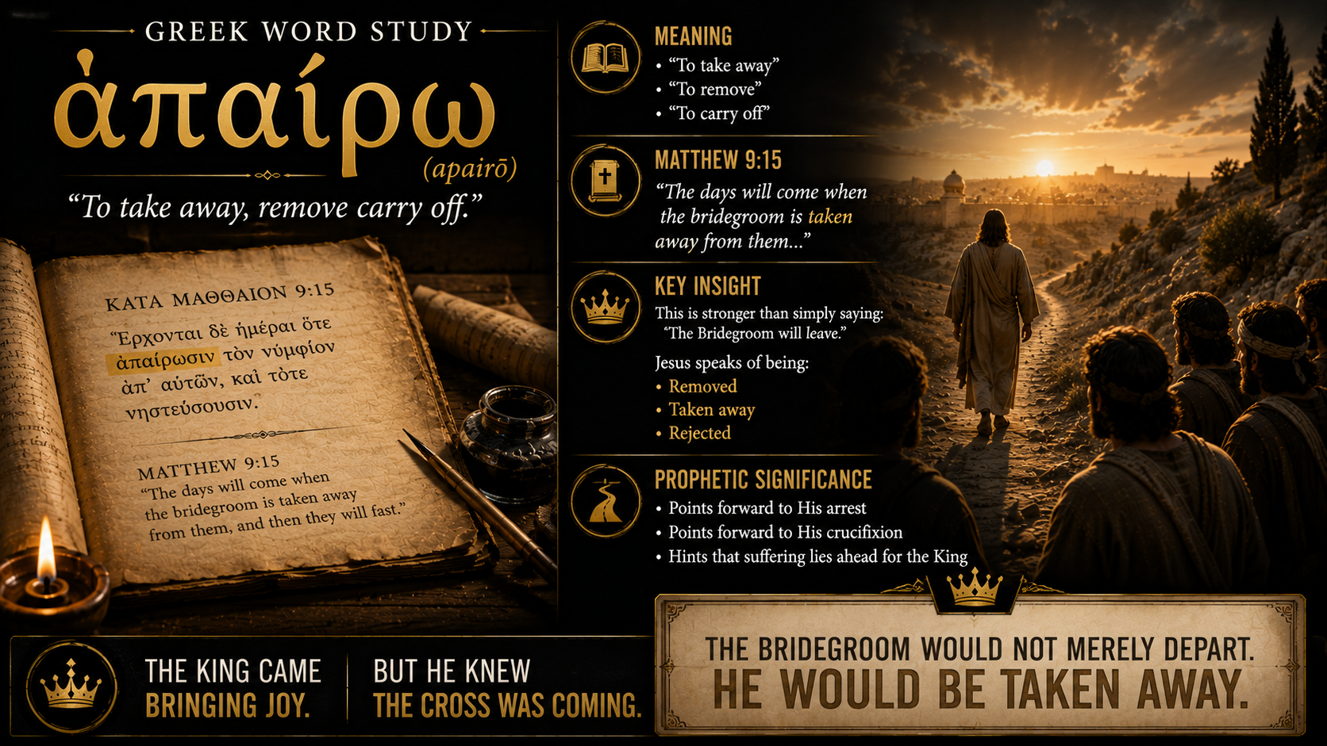
Notes:
(GO OVER THE SLIDE)

Slide 24
Notes:
The disciples may not fully understand it yet, but Jesus knows where His authority will take Him. The King who brings the kingdom will also be rejected by the old wineskins. The Bridegroom will be taken away. After that, Jesus says, “then they will fast.”

Slide 25
Notes:
Fasting will return, but it will return on the other side of His death. It will no longer be fasting as a badge of religious superiority. It will no longer be fasting as a way to prove seriousness before men. It will be fasting shaped by longing, dependence, grief, mission, and anticipation.

Slide 26
Notes:
So, Jesus’ answer gives fasting a Christ-centered meaning.
When the Bridegroom is present, joy is fitting.
When the Bridegroom is taken away, fasting will be fitting.
The practice is not rejected. It is reoriented around Jesus.

Slide 27
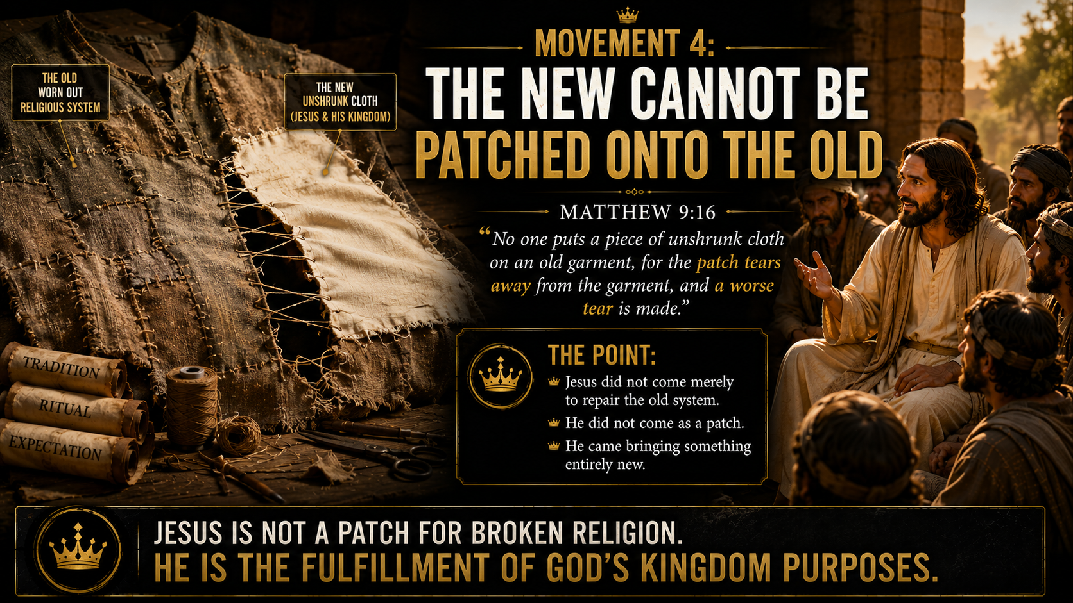
Notes:
(READ THE SLIDE FIRST – TITLE AND SCRIPTURE ONLY)
Jesus now gives the first of two illustrations. The first is about clothing.
No one takes unshrunk cloth and uses it to patch an old garment. The reason is simple. When the new patch shrinks, it pulls against the older fabric.
Instead of fixing the garment, it makes the tear worse.
The point here isn’t difficult to understand, but it is powerful.

Slide 28
Notes:
Jesus didn’t come as a new small patch to repair the old religious system. He didn’t come merely to improve it, decorate it, or make it more effective.
He came to fulfill and to bring something new.

Slide 29
Notes:
The word “unshrunk” refers to cloth that has not yet gone through the shrinking process. It is new, fresh, and not yet settled. If it is attached to old, worn fabric, the two will not work together.
Jesus is saying that His kingdom and His coming cannot simply be stitched onto the existing expectations of first-century religious life.

Slide 30
Notes:
The old garment represents the existing religious framework, especially as it had developed around external performance, ritual expectation, and man-made standards of holiness.
The new cloth represents the kingdom reality arriving in Jesus.
The issue is incompatibility.

Slide 31
Notes:
Jesus can’t be reduced to a reform movement inside Pharisaic religion. He can’t be added to a system built on outward appearance, ritual status, and human expectation.
The old garment cannot carry who Jesus really is.
And if people try to force Jesus into that system, the result won’t be preservation. It’ll be destructive.

Slide 32
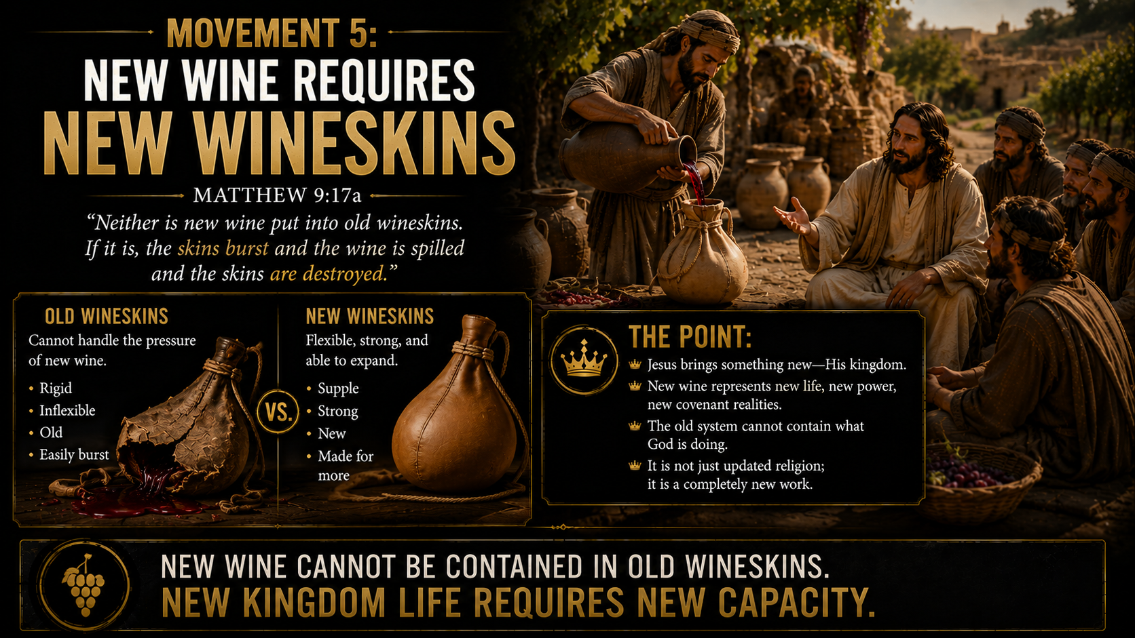
Notes:
(READ THE SLIDE FIRST – TITLE AND SCRIPTURE ONLY)
Jesus gives a second illustration, this time from the world of wine storage.
In the ancient world, wine was often stored in animal skins. A fresh wineskin had flexibility. It could stretch as the new wine fermented and expanded. But an old wineskin had already become stretched, dry, and brittle. If new wine continued to ferment inside it, the pressure would burst the skin.

Slide 33
Notes:
The result would be total loss. The wine would spill. The wineskin would be ruined.
The point is clear: new wine requires a fitting new container.
Jesus is the new wine. His kingdom is the new reality. His presence, His authority, His mission, His mercy, His forgiveness, and His coming death and resurrection cannot be contained within old religious expectations.

Slide 34
Notes:
Again, Jesus isn’t saying the Old Testament was wrong. He isn’t rejecting the Law and the Prophets. Matthew has already shown us that Jesus fulfills them.
The problem isn’t the Old Testament.
The problem is the religious system that had grown around it, a system that couldn’t recognize fulfillment when Fulfillment stood in front of them.

Slide 35
Notes:
The old wineskins represent rigid religious forms that can’t stretch around the arrival of the King.
They can’t contain mercy toward tax collectors, forgiveness for sinners, joy in the presence of the Bridegroom, or a kingdom that comes through grace, restoration, and eventually the cross.
The religious leaders wanted Jesus to fit their categories. But Jesus didn’t come to fit their categories.
He came to fulfill God’s purposes.

Slide 36
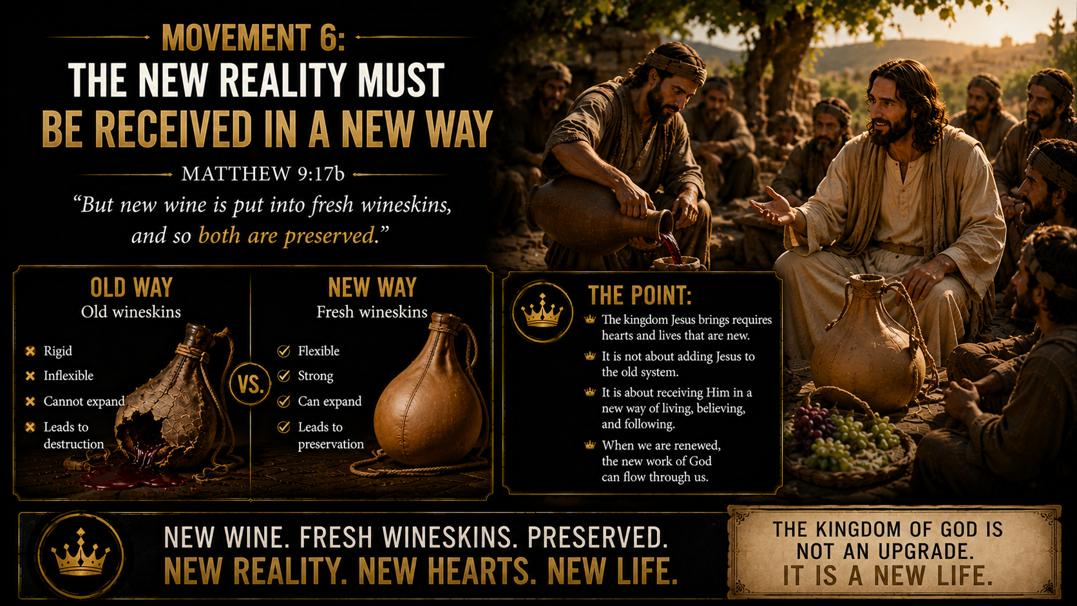
Notes:
(READ THE SLIDE FIRST – TITLE AND SCRIPTURE ONLY)
Jesus ends with preservation, not destruction.
And that’s important.
The goal isn’t to destroy everything old simply because it’s old. The goal is to receive the reality of the kingdom in the way God intends.
New wine belongs in fresh wineskins.

Slide 37
Notes:
The word translated “fresh” carries the idea of newness, usefulness, and suitability. The point is that the container must match the reality it holds.
Jesus is bringing the new covenant realities of God’s kingdom. That requires a new framework centered on Him.

Slide 38
Notes:
Not ritual as the center.
Not fasting as the center.
Not religious appearance as the center.
Not man-made tradition as the center.
Christ is the center.

Slide 39
Notes:
His presence defines joy.
His absence defines longing.
His authority defines practice.
His mission defines the people of God.
His death and resurrection define the new covenant.

Slide 40
Notes:
When the new wine is placed in fresh wineskins, both are preserved. The wine isn’t lost, and the container isn’t destroyed.
Jesus isn’t careless with God’s purposes. He isn’t bringing chaos. He’s bringing fulfillment.
But fulfillment cannot be contained by systems that refuse to stretch/bend/bow before the King.

Slide 41
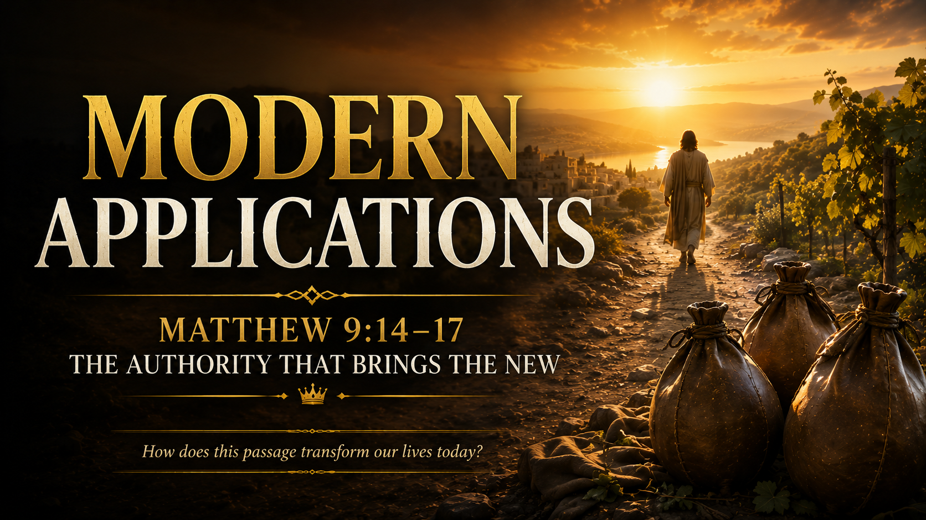

Slide 42
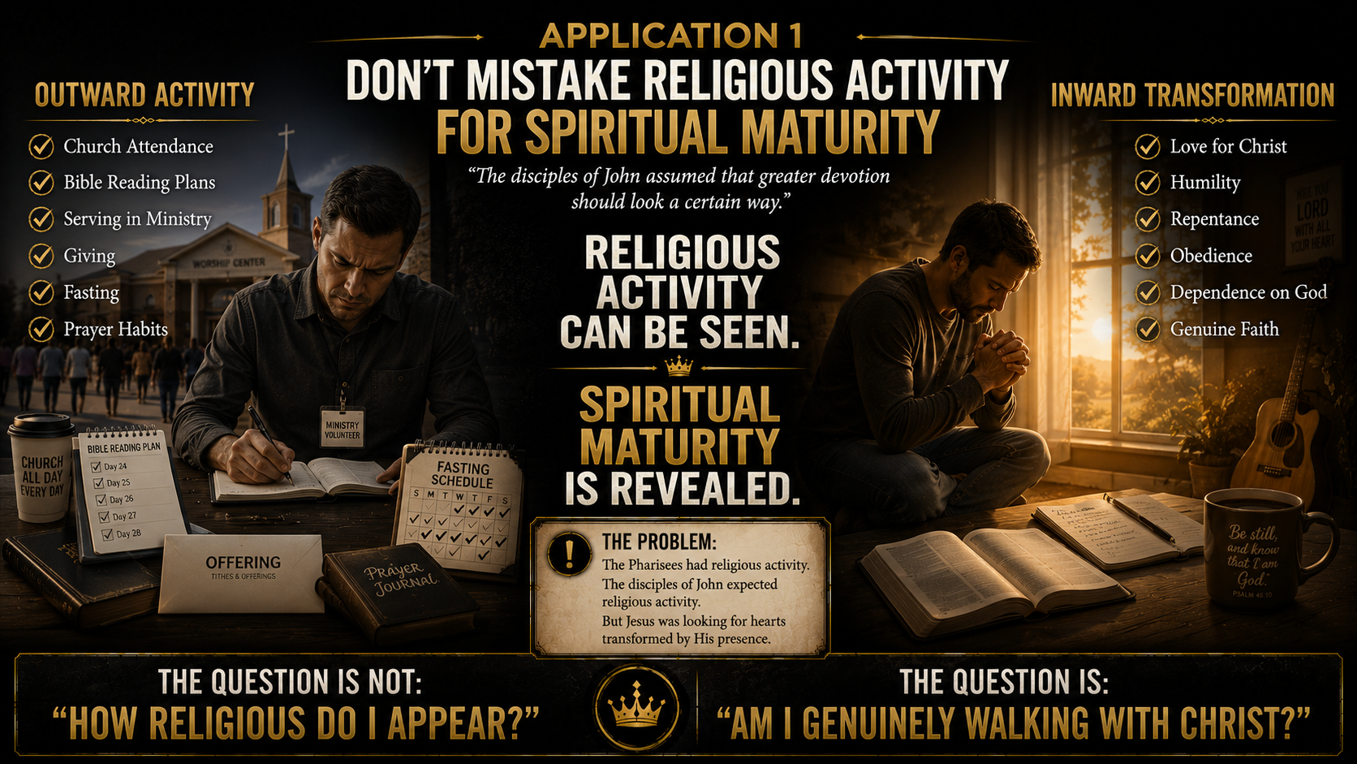

Slide 43
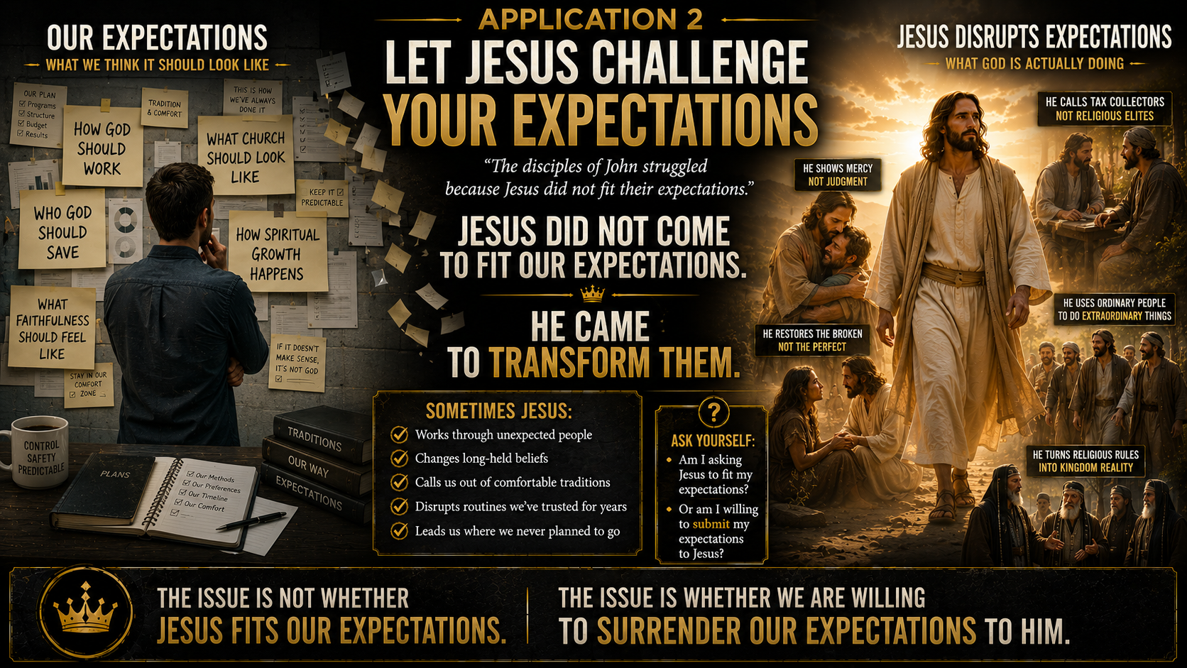

Slide 44


Slide 45
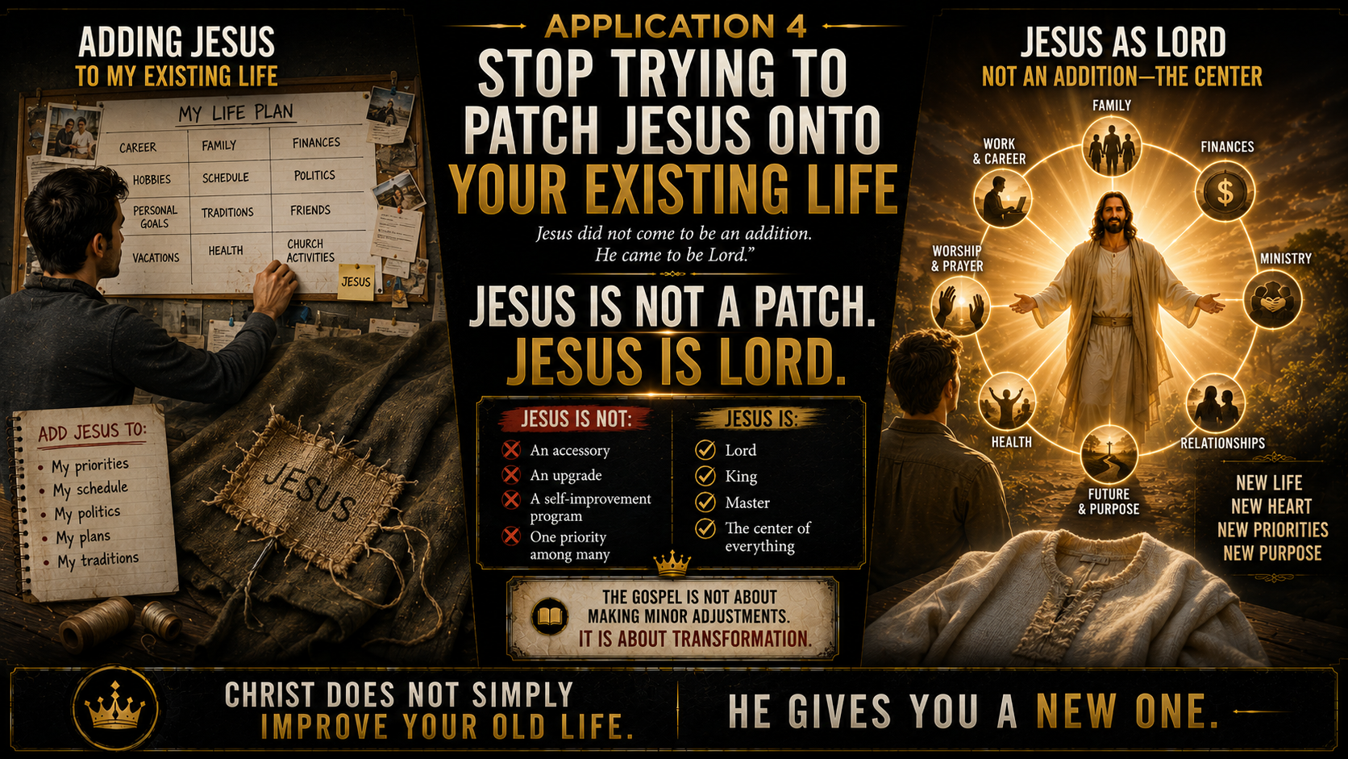

Slide 46
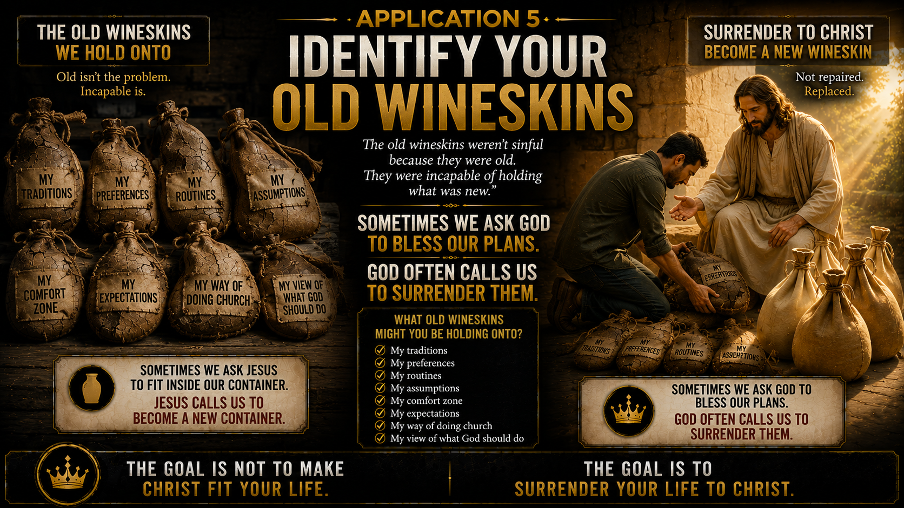

Slide 47
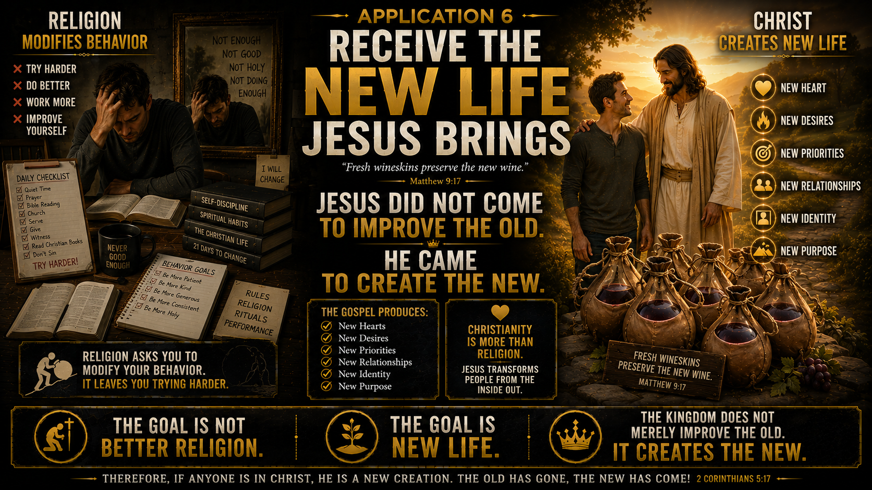

Slide 48
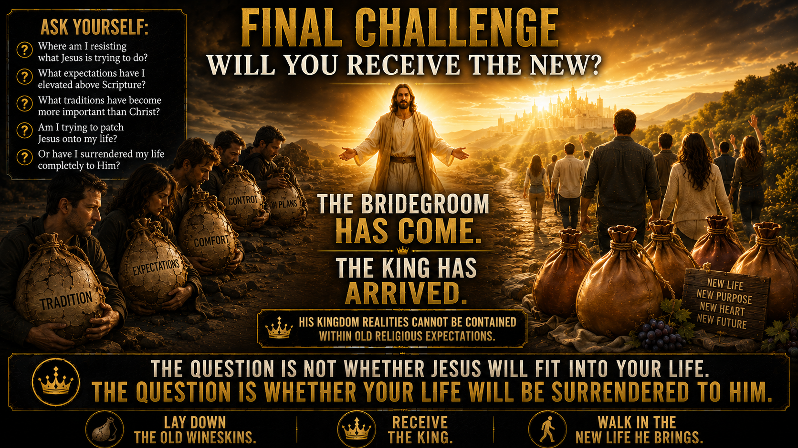

Slide 49
Notes:
Several months passed after the new manager took over the family business.
At first, many employees resisted his changes. They complained about the new systems.
They questioned the new priorities. They compared everything to the way things used to be.
Some spent so much time protecting the old routines that they never really learned the new ones.
A few eventually left. They simply couldn't accept that the company was changing.

Slide 50
Notes:
But others made a different choice. Instead of fighting every change, they began listening.
Instead of comparing everything to the past, they began learning.
Instead of asking, "Why can't things stay the way they were?" they started asking, "What is the manager trying to accomplish?"
And something interesting happened. The longer they worked under the new manager, the more they understood his vision.

Slide 51
Notes:
The new systems weren't random. The new priorities weren't arbitrary.
The changes weren't meant to make their lives harder.
They were designed to make the business healthier, stronger, and more effective than it had ever been before.

Slide 52
Notes:
One day, one of the more stubborn employees realized something.
The problem had never been the manager.
The problem had been his unwillingness to let go of the old way of doing things.
He had spent months asking the wrong question.
He kept asking: "Why doesn't the manager fit into our system?"
When the real question was: "Why am I resisting the manager's vision?"

Slide 53
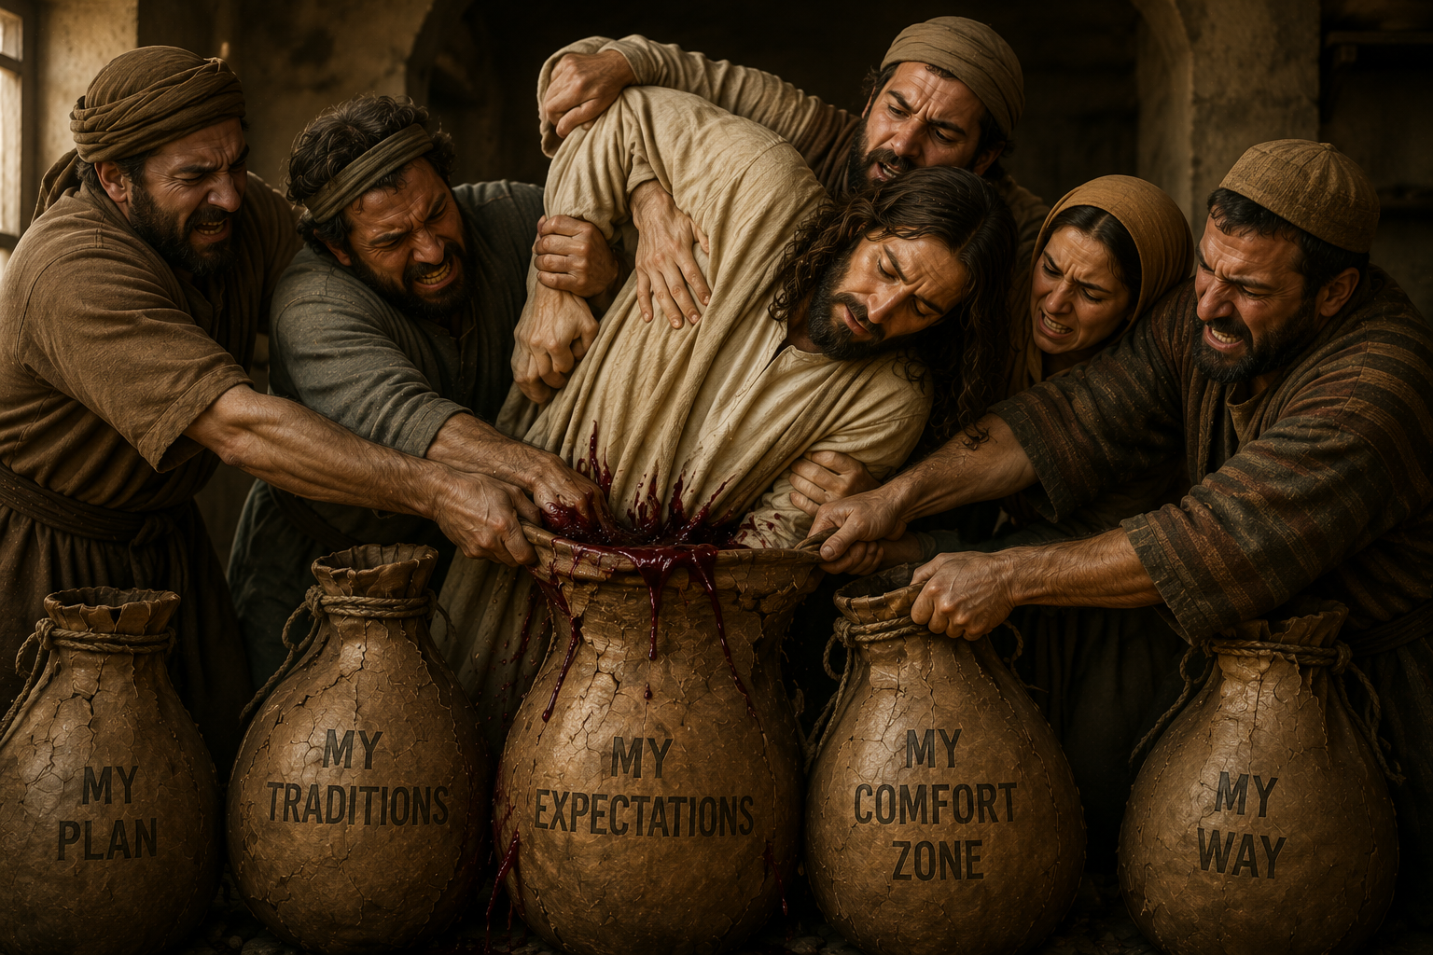
Notes:
That is exactly what Jesus confronts in Matthew 9.
The disciples of John and the Pharisees wanted Jesus to fit into the religious expectations they already understood.
They wanted Him to fit their categories.
Their traditions. Their assumptions. Their way of measuring faithfulness.

Slide 54
Notes:
But Jesus didn't come to fit into their system.
He came to bring something entirely new.
The Bridegroom had arrived. The King had come.
The kingdom was breaking into the world.
And the old wineskins could not contain what He came to accomplish.

Slide 55
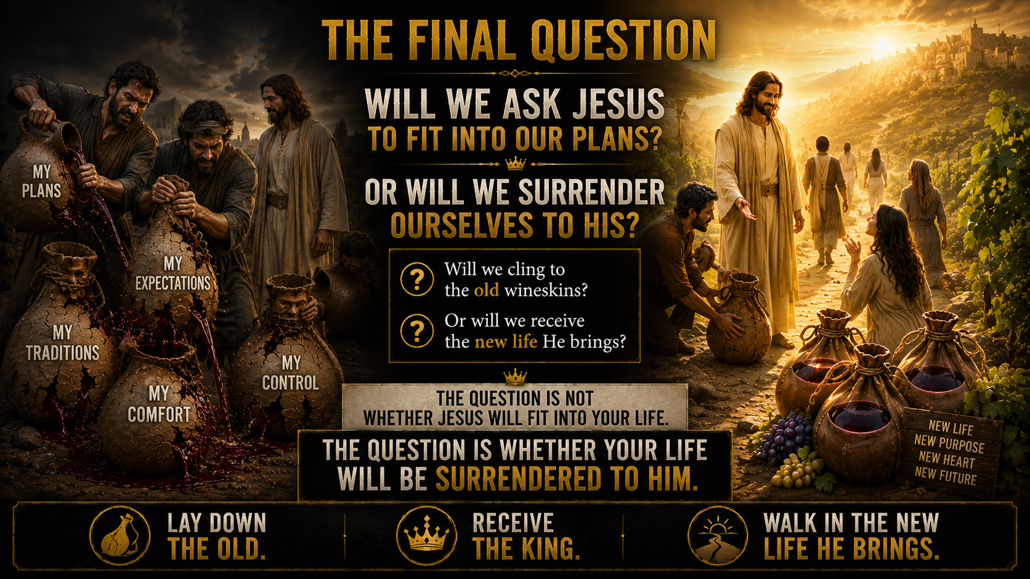

Slide 56
