Slide 1
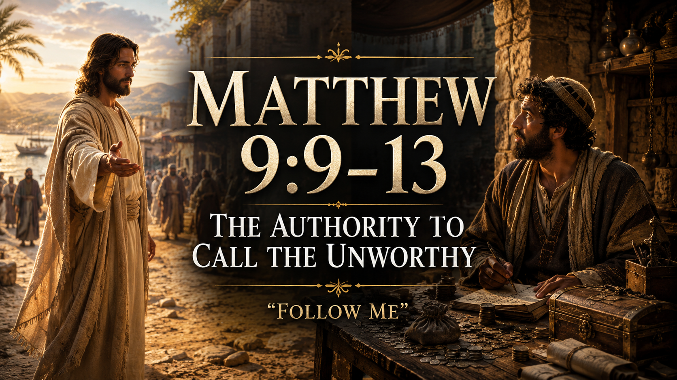

Slide 2


Slide 3

Notes:
There was a successful business owner in a small town who had built a company from nothing.
For thirty years, he had worked long hours, sacrificed vacations, missed sleep, and poured his life into the business. Eventually, it became one of the most respected companies in the region.
People wanted to work there. People admired it. People talked about it.

Slide 4

Notes:
When the company reached its thirtieth anniversary, the owner decided to host a special banquet for all of his employees.
It would be held at the nicest venue in town.
The food would be catered. Awards would be given. Stories would be shared.
It would be a celebration of everything they had built together.

Slide 5

Notes:
As preparations began, the owner instructed his assistant to prepare invitations for every employee.
Then he paused. "There’s one more person I want invited."
The assistant looked confused. "Who?"
The owner gave the name.
The assistant immediately knew who he was talking about.

Slide 6
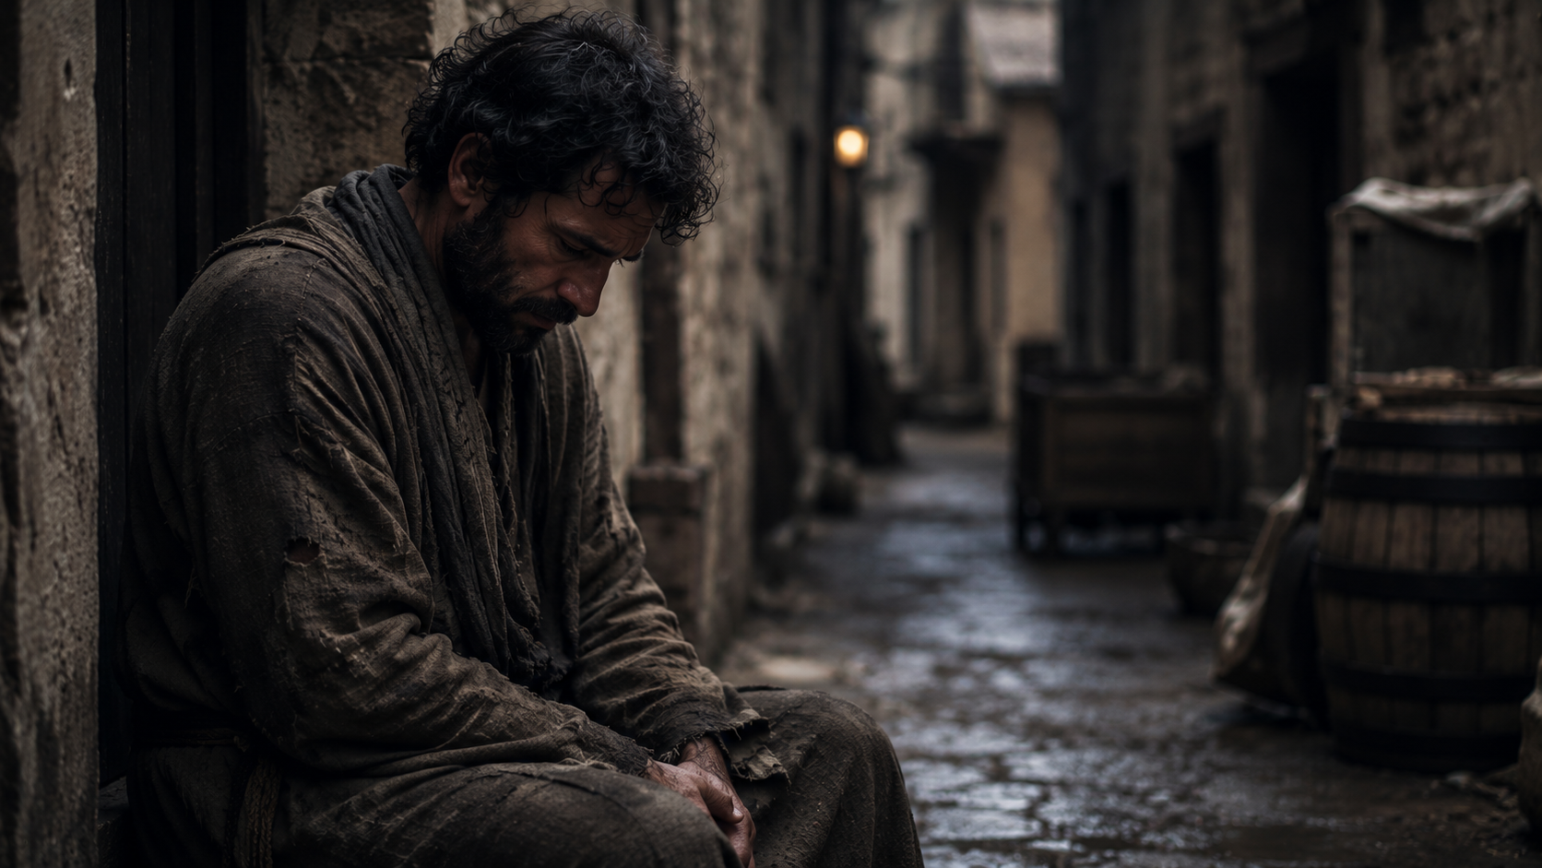
Notes:
Everyone in town knew.
The man's reputation was terrible.
Years earlier he had worked for the company but had been caught stealing.
Not once. Not twice. But repeatedly.
When he was finally confronted, he lied about it.

Slide 7
Notes:
When the evidence became undeniable, he blamed others. Eventually he was fired.
The story spread throughout town. No one trusted him anymore.
He bounced from job to job. People crossed the street to avoid him.
Parents warned their children not to become like him.
Even years later, his name still carried a stain.

Slide 8
Notes:
The assistant stared at the owner. "Surely you don't mean him."
"I do.“ "But after everything he did?"
"Yes.“ "What if people get upset?"
"They probably will."

Slide 9
Notes:
“He surely doesn’t deserve it?"
The owner smiled. "Of course he doesn't deserve it. That's why I want him there."
The assistant didn't know what to say.

Slide 10
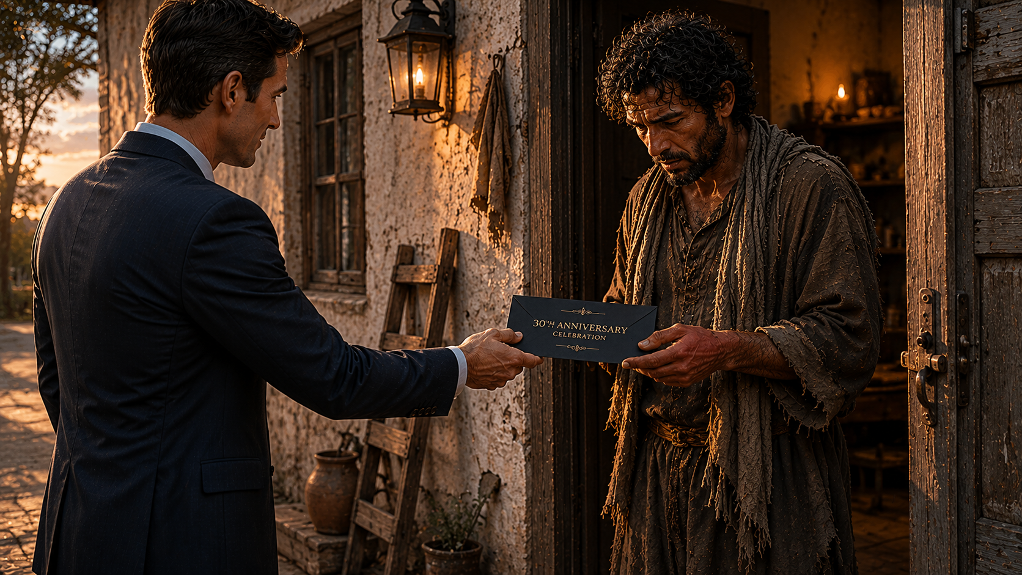
Notes:
A few days later, the assistant drove across town and knocked on the man's door.
The man opened it cautiously.
The assistant handed him the invitation.
The man looked at it.
Then looked at the assistant.
Then back at the invitation.

Slide 11
Notes:
"There must be some mistake.“ "There isn't."
"I think you have the wrong person.“ "I don't."
The man laughed nervously. "You know who I am, right?“ "I do."
"You know what I've done?“ "I do."

Slide 12
Notes:
"And he still wants me to come?“ "Yes."
The man's eyes filled with tears.
For a long moment he just stood there holding the invitation.
Finally, he whispered, "Why?"
The assistant thought about the owner's words. Then he answered:
"Because the invitation was never about what you've done."
"It's about who he is."

Slide 13

Notes:
The night of the banquet arrived.
The room was filled with respected employees.
Managers. Supervisors. Executives.
People with spotless records.
People everyone admired.

Slide 14
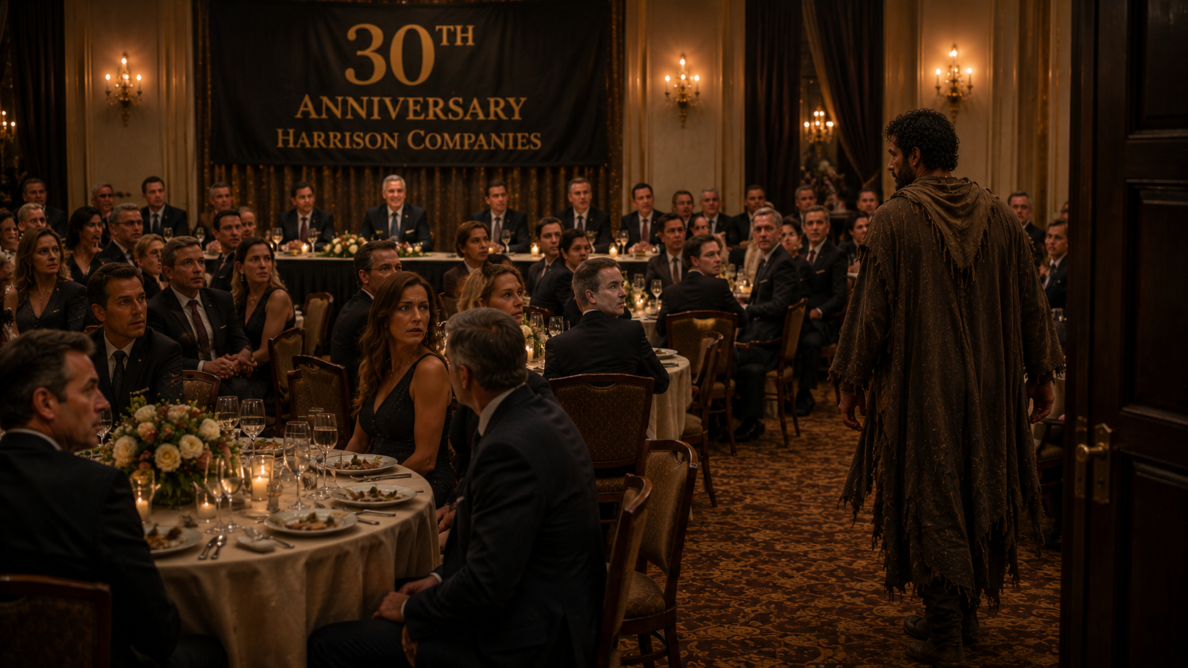
Notes:
Then the doors opened.
And in walked the disgraced man.
Immediately, the room grew quiet.
Some whispered.
Everyone stared.

Slide 15
Notes:
A few shook their heads.
One person muttered, "What's he doing here?"
Another said, "He shouldn't be here."
A third replied, "After everything he did, how could the owner even invite him?"

Slide 16
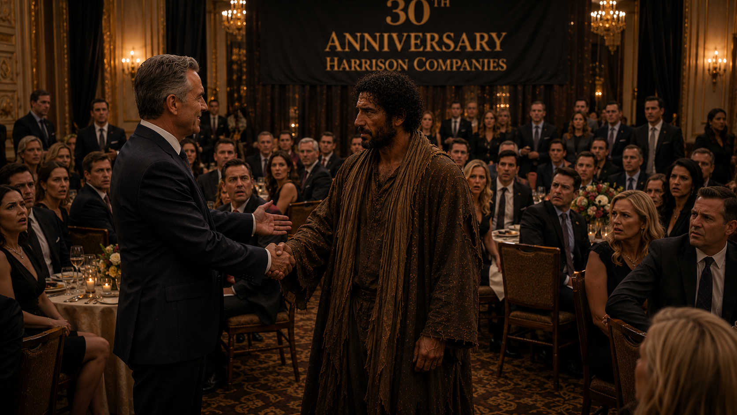
Notes:
The owner heard the whispers.
He stood from his seat.
Walked across the room.
And before everyone watching, he greeted the man warmly.
Smiled at him and shook his hand.

Slide 17
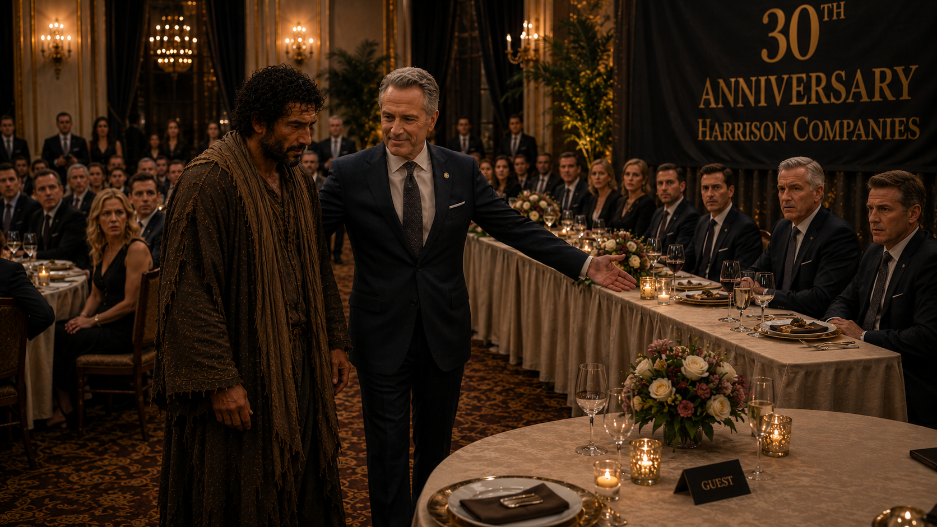
Notes:
And personally escorted him to a seat near the front.
The room couldn't understand it.
But the owner could.
Because while everyone else saw a failure...
The owner saw someone worth pursuing.

Slide 18
Notes:
While everyone else saw a ruined reputation...
The owner saw an opportunity for mercy.
While everyone else saw a man who didn't belong...
The owner wanted him at the table.

Slide 19
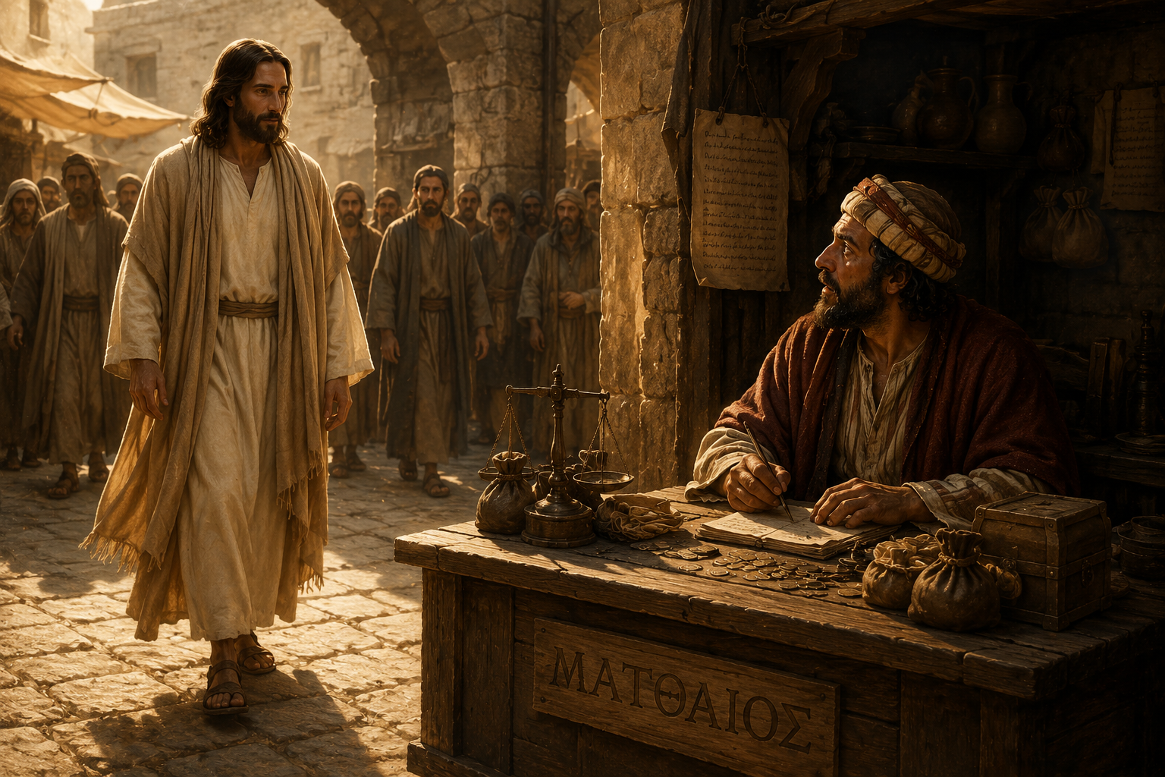
Notes:
And that's where our story today begins.
In Matthew 9, Jesus walks toward a man with a ruined reputation.
A man most religious people wanted nothing to do with.
A man many believed was beyond redemption.
And instead of avoiding him...
Jesus walks up to him and invites him to the table.

Slide 20


Slide 21
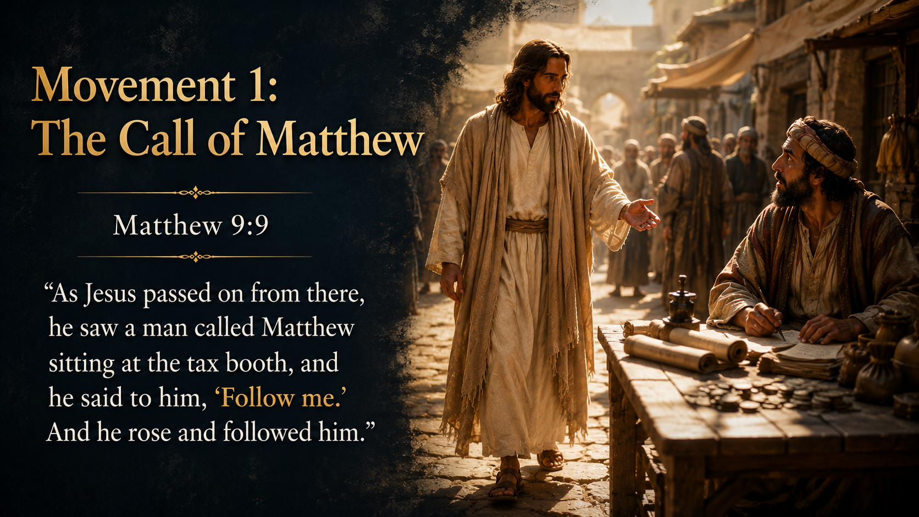
Notes:
(READ THE SLIDE FIRST) Matthew 9:9 begins with the phrase, “As Jesus passed on from there.”
This connects directly to the previous scene where Jesus healed the paralytic and demonstrated His authority to forgive sins. Jesus is still in the region of Capernaum, moving through a place where commerce, travel, and taxation would have been common.

Slide 22
Notes:
Then Matthew writes, “he saw a man called Matthew.”
This is important because Matthew is writing about himself. Mark and Luke identify him as Levi, but here he uses the name Matthew, which means something like “gift of God.” He doesn’t hide his past. He records his own calling with striking simplicity.

Slide 23
Notes:
Tax collectors were despised. They collected revenue for Rome, often from their own Jewish people. They were viewed as collaborators with Gentile oppressors and were commonly associated with greed, dishonesty, and betrayal. Matthew says Jesus saw him “sitting at the tax booth.”

Slide 24
Notes:
The tax booth was likely a customs station where taxes were collected on goods, travel, fishing, trade, or transport. Since Capernaum was near important roads and the Sea of Galilee, this would have been a strategic place for collecting tolls.
Then Jesus says, “Follow me.”

Slide 25
Notes:
The phrase is simple but authoritative. Jesus doesn’t ask Matthew to admire Him, agree with Him, or respect Him. He calls him into discipleship.
In the first-century Jewish world, disciples usually sought out rabbis. Here, Jesus does the seeking. He approaches the tax collector and calls him.

Slide 26
Notes:
Matthew writes, “And he rose and followed him.”
The response is immediate. The tax booth represents Matthew’s old life, old income, old identity, and old allegiance. Rising from that place marks a decisive break. The man known as a tax collector becomes a follower of Jesus.

Slide 27
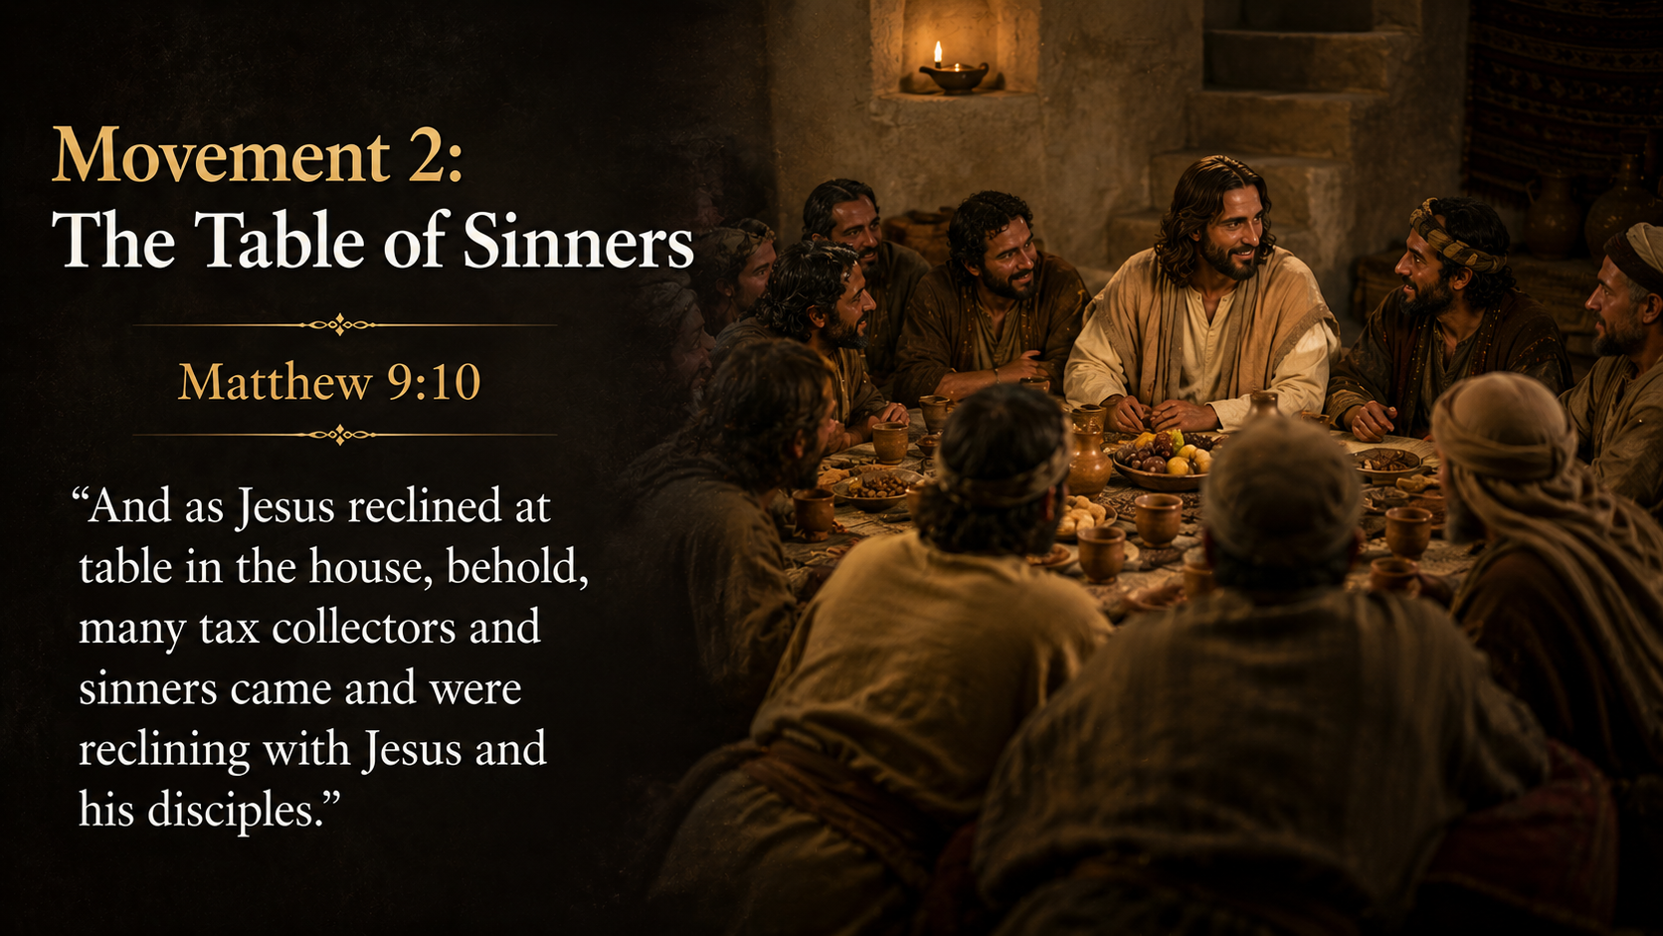
Notes:
(READ THE SLIDE FIRST) The next scene moves from the tax booth to a meal.
Matthew writes, “as Jesus reclined at table in the house.”
In that culture, formal meals were often eaten while reclining. This wasn’t fast food or casual snacking. Reclining at table suggested fellowship, welcome, relationship, and shared life.

Slide 28
Notes:
The phrase “in the house” is likely Matthew’s house. Luke’s Gospel tells us Levi made Jesus “a great feast” in his house. Matthew doesn’t emphasize his own hospitality, but the scene strongly suggests that Matthew has invited Jesus and others into his home.

Slide 29
Notes:
Then Matthew says, “behold.”
That word signals a surprise. It invites the reader to notice something unexpected. What’s unexpected?
“Many tax collectors and sinners came.”

Slide 30
Notes:
Matthew wasn’t alone. His circle of relationships was filled with people who shared his reputation. Tax collectors gathered with tax collectors. Social outcasts gathered with social outcasts.
The phrase “tax collectors and sinners” wasn’t neutral. It was a category used by religious people to describe those viewed as morally compromised, ceremonially unclean, or socially shameful.

Slide 31
Notes:
“Sinners” here doesn’t mean that the Pharisees believed they themselves had no sin at all. It refers to people publicly known for lifestyles outside the accepted boundaries of religious respectability.

Slide 32
Notes:
Then Matthew says they were “reclining with Jesus and his disciples.”
This is the scandal of the scene. Jesus isn’t merely speaking to them from a safe distance. He’s sharing a table with them. In that culture, table fellowship was meaningful. To eat with someone was to be associated with them.
This meal becomes a visible picture of Jesus’ mission.

Slide 33
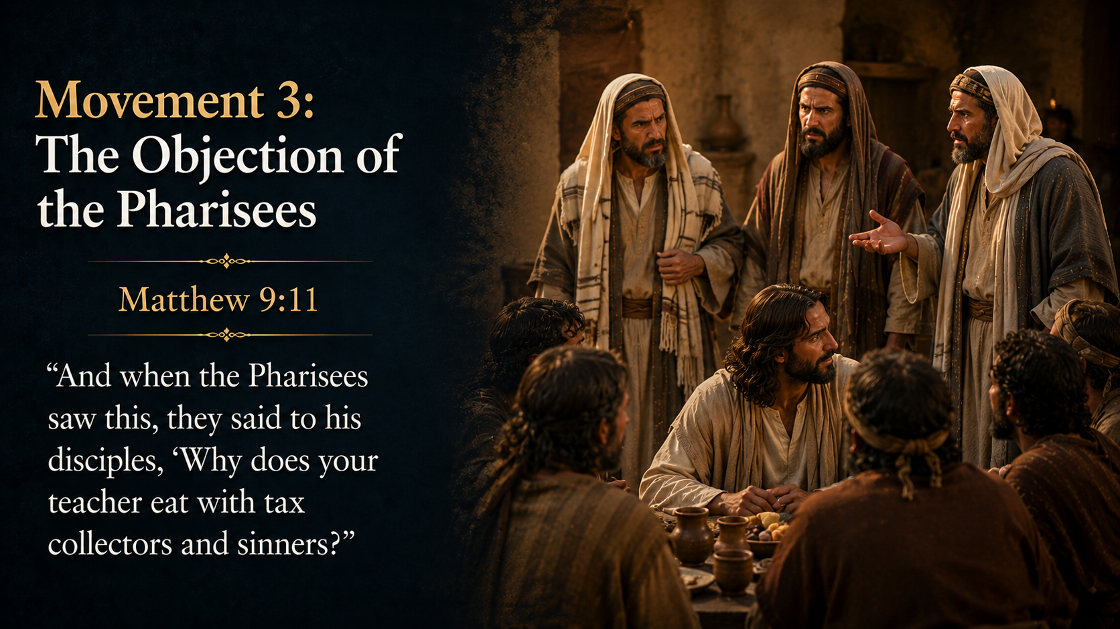
Notes:
(READ THE SLIDE FIRST) Matthew now introduces the Pharisees.
The Pharisees were a respected religious movement committed to careful obedience, ritual purity, and separation from anything they believed would defile them. Their concern wasn’t casual. They believed holiness had to be guarded.

Slide 34
Notes:
Matthew says, “when the Pharisees saw this.”
They see the meal. They see the guests. They see Jesus’ association with people they considered spiritually contaminated.
Their question is then directed to the disciples:
“Why does your teacher eat with tax collectors and sinners?”

Slide 35
Notes:
Notice they don’t ask Jesus directly. They ask His disciples. The question carries an accusation.
The phrase “your teacher” is significant. Jesus is being evaluated as a rabbi. In their eyes, a true teacher of righteousness should know better than to share table fellowship with such people.

Slide 36
Notes:
The heart of their concern is the word “eat.”
Again, eating together meant fellowship. Their objection isn’t merely that Jesus spoke to sinners. Their objection is that He welcomed them so closely that they shared a meal.
To the Pharisees, this looked like a compromise. To Jesus, it was a mission.

Slide 37
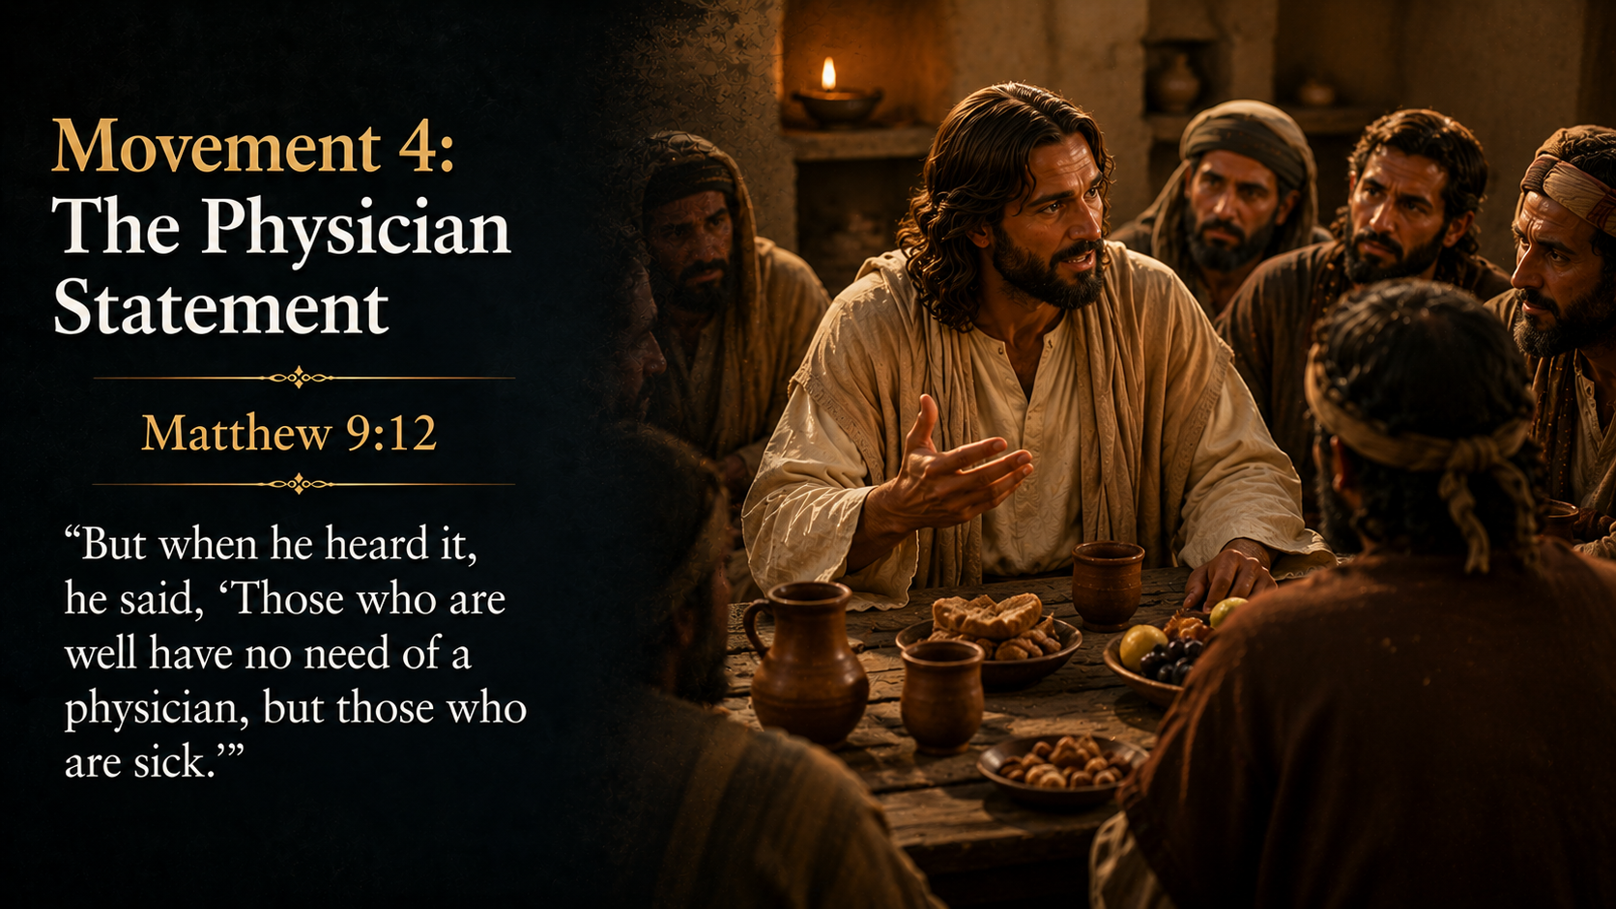
Notes:
(READ THE SLIDE FIRST) Matthew says, “But when he heard it.”
Jesus hears the question, even though it was addressed to His disciples. He answers directly because the question concerns His identity and mission.
Jesus says, “Those who are well have no need of a physician, but those who are sick.”
This is a proverb-like statement. It’s simple, memorable, and impossible to misunderstand.

Slide 38
Notes:
A physician doesn’t avoid sick people because they are sick. The presence of sickness is the reason the physician comes near.
Jesus isn’t saying the Pharisees are truly spiritually healthy. He’s exposing the difference between those who recognize their sickness and those who don’t.
The tax collectors and sinners are obviously sick in the eyes of society.

Slide 39
Notes:
The Pharisees are sick too, but they just don’t see it.
The image of Jesus as a physician also fits the larger movement of Matthew 8–9. Jesus has been healing physical sickness, but now the focus moves to spiritual sickness. Sin is being pictured as a disease that requires divine mercy, not mere religious distance or disdain.

Slide 40
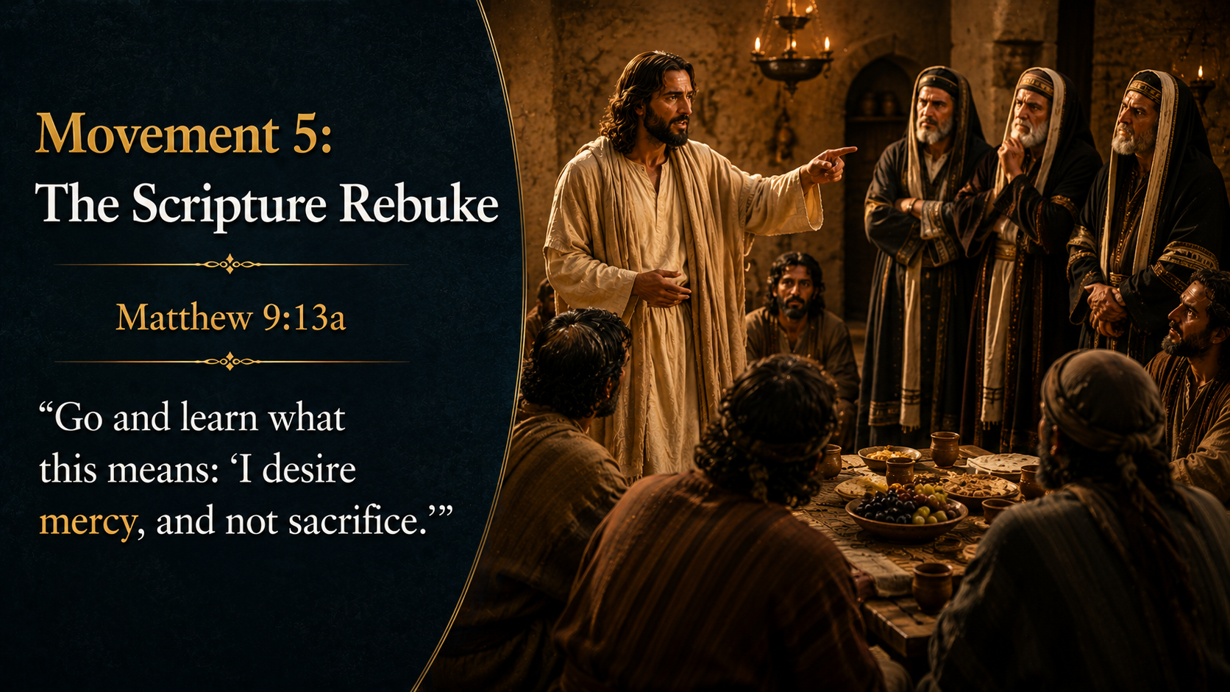
Notes:
(READ THE SLIDE FIRST) Jesus then says, “Go and learn what this means.”
This was a sharp statement. These were religious teachers. They knew Scripture. They studied Scripture. They taught Scripture.
Yet Jesus tells them they still need to learn what Scripture means.

Slide 41
Notes:
He quotes Hosea 6:6:
“I desire mercy, and not sacrifice.”
In Hosea’s day, Israel maintained surface-level religious activity while lacking covenant faithfulness, love, and mercy.
They had sacrifices, but their hearts were far from God.
Jesus applies that same prophetic rebuke to the Pharisees.

Slide 42
Notes:
The word “mercy” carries the idea of compassion, covenant love, kindness, and loyal concern for the needy. God doesn’t reject sacrifice itself, since sacrifice was commanded under the Law. The point is priority.
God doesn’t want ritual without mercy. He doesn’t want religious precision without compassion.
He doesn’t want outward separation that lacks His heart for sinners. The Pharisees had a category for sacrifice.
Jesus says they needed to recover God’s heart of mercy.

Slide 43
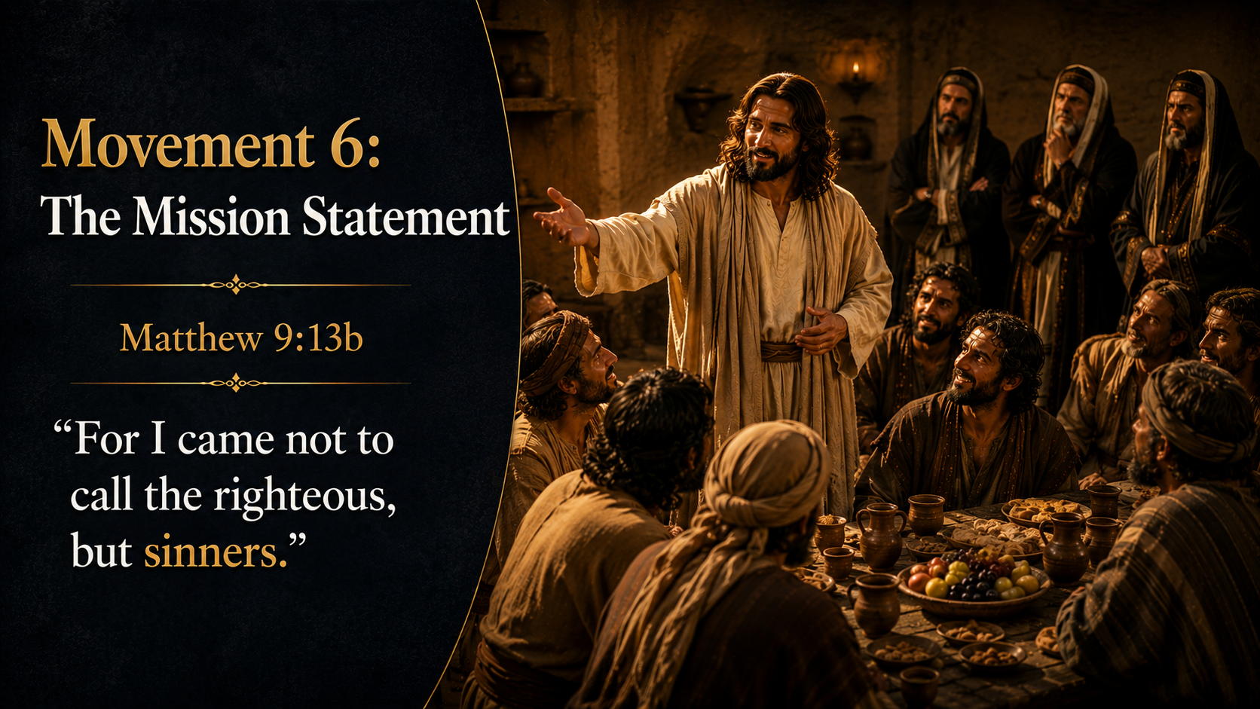
Notes:
(READ THE SLIDE FIRST) Jesus ends with the purpose statement: “For I came.”
This points to His mission. Jesus isn’t acting randomly. He is fulfilling the very reason He came.
Then He says, “not to call the righteous, but sinners.”
The word “call” connects back to verse 9: “Follow me.”

Slide 44
Notes:
Matthew’s call is now explained. What happened at the tax booth wasn’t an isolated act of kindness.
It was a living example of Jesus’ mission. Jesus came to call sinners.
The phrase “not the righteous” doesn’t mean there are truly righteous people who don’t need Him. It refers to those who consider themselves righteous and therefore see no need for mercy.

Slide 45
Notes:
The contrast is between the self-satisfied and the needy.
The religiously confident and the repentant.
Those who think they belong and those who know they do not.
This final sentence explains the whole passage.
Jesus has the authority to call the unworthy because His mission is to show mercy to them.
And in the big picture, everyone is unworthy!

Slide 46
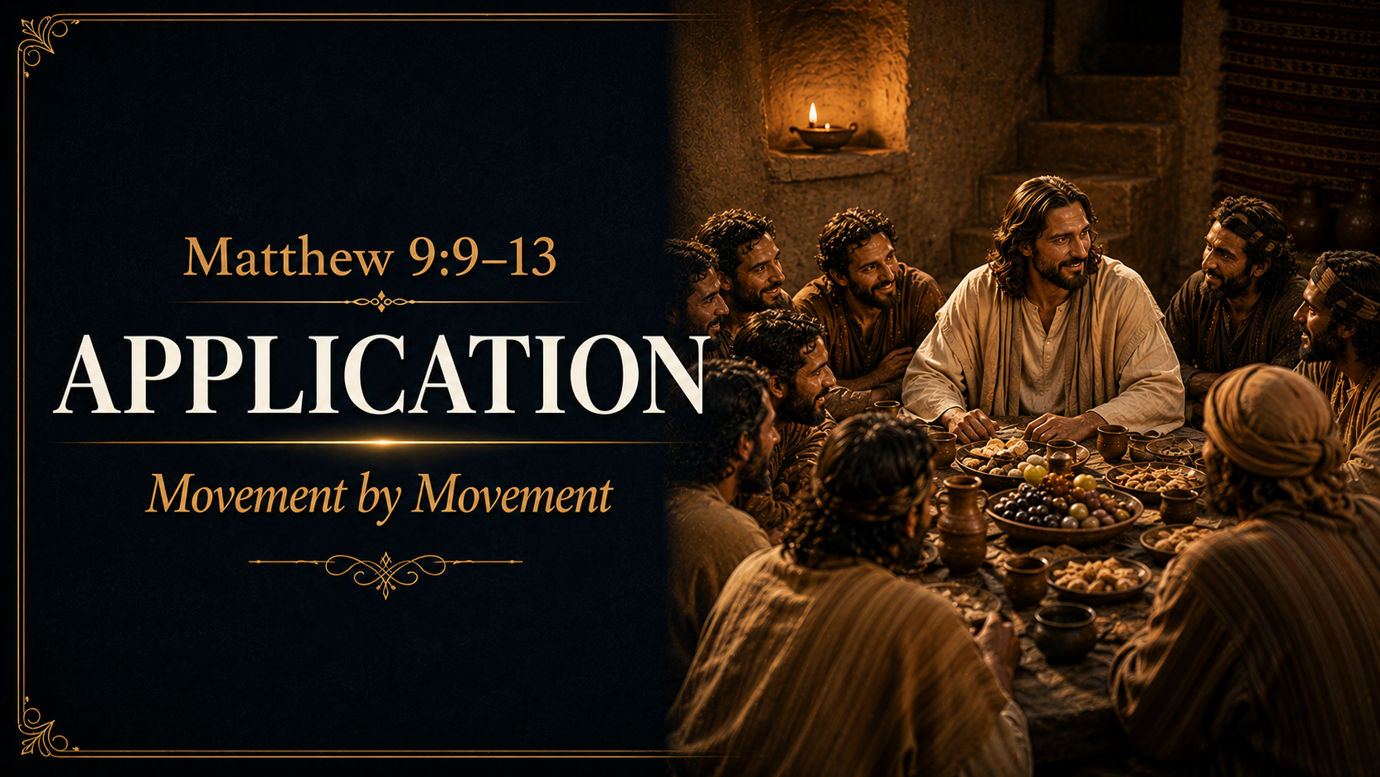

Slide 47
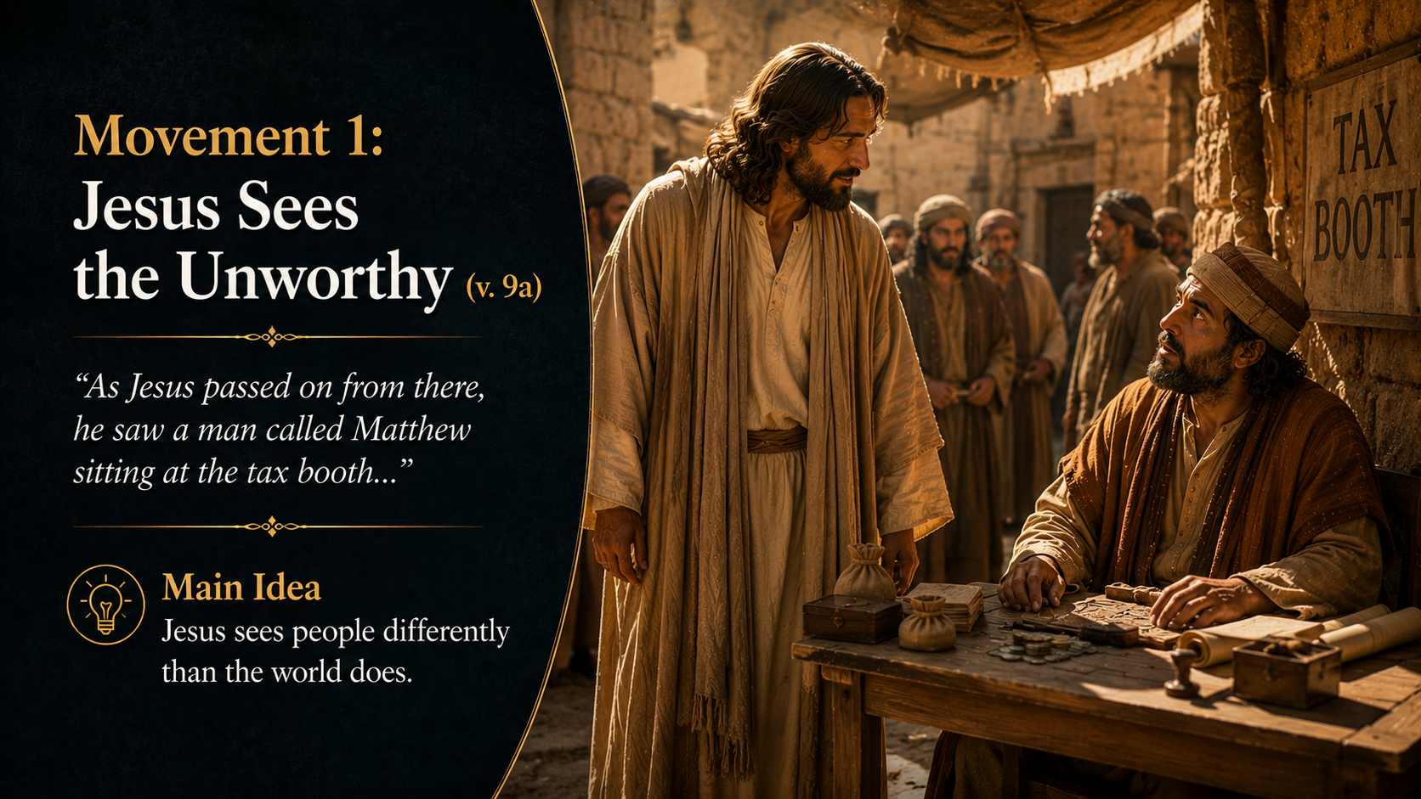
Notes:
Matthew was invisible to the people who mattered and hated by the people who knew him.
Most people saw a tax collector.
Jesus saw a future disciple.
The same is true today.
The world tends to define people by their failures, reputation, politics, addictions, mistakes, or past decisions.

Slide 48
Notes:
Jesus sees beyond all of that.
He sees what His grace can make a person become.
Before we write someone off, we should remember that Jesus never wrote Matthew off.
Question: Who am I tempted to see the way the world sees them instead of the way Jesus sees them?

Slide 49
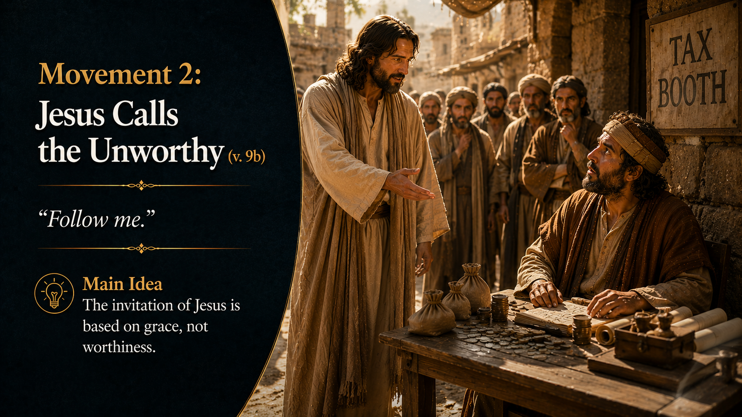
Notes:
Nobody earns an invitation from Jesus.
Matthew didn’t clean himself up first.
He didn’t prove himself worthy.
He simply received the call.

Slide 50
Notes:
The gospel begins with grace.
Many people delay coming to Christ because they think they need to fix themselves first.
Jesus calls imperfect sinners, not perfect finished products.

Slide 51
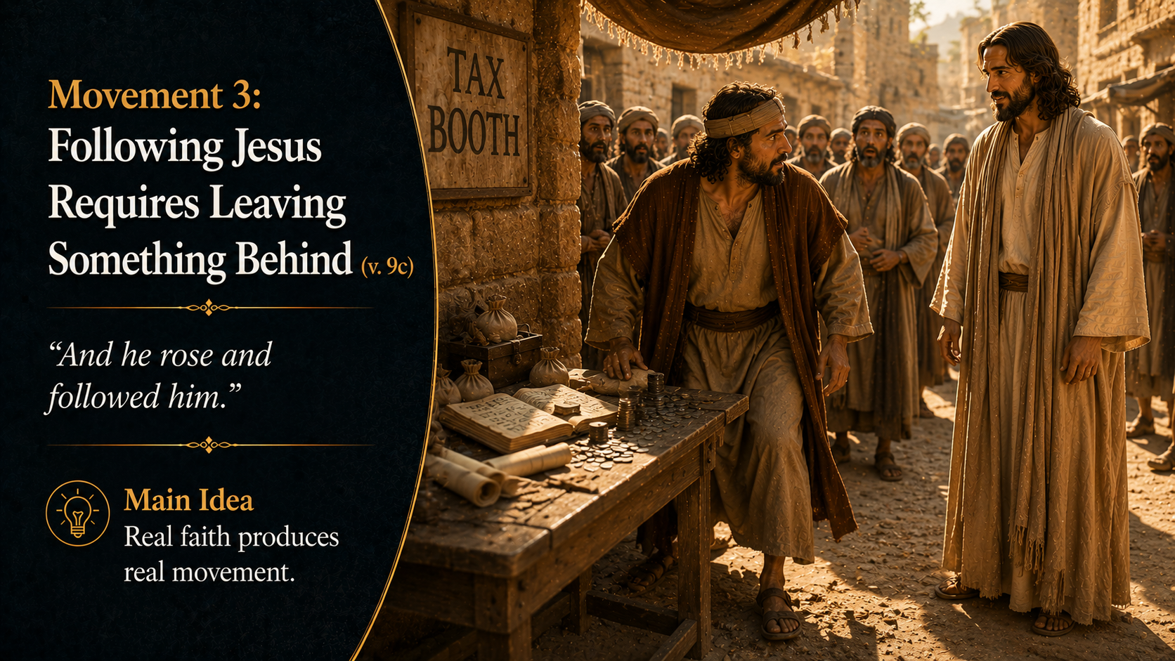
Notes:
Matthew couldn’t remain at the tax booth and follow Jesus at the same time.
Following Christ always involves leaving something behind.
For some it may be sin.
For others it may be pride, comfort, fear, bitterness, or self-reliance.

Slide 52
Notes:
Real faith moves.
The question isn’t whether Jesus has called.
The question is whether we are willing to rise and follow.

Slide 53
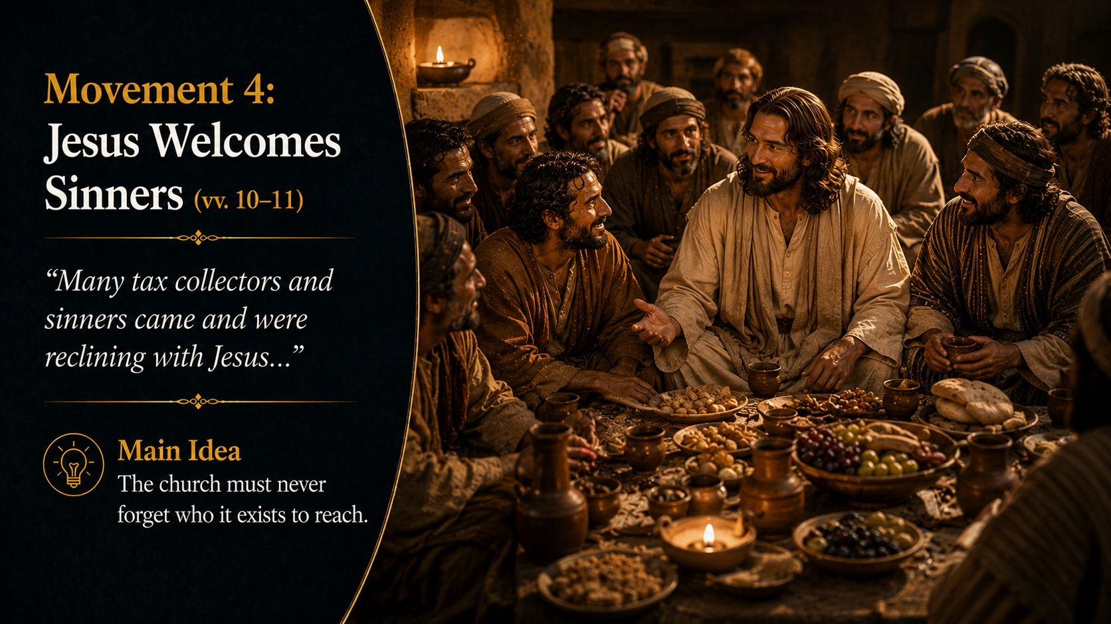
Notes:
The banquet shows us the heart of Jesus.
He intentionally spent time with people who knew they needed His mercy.
The church exists for the same purpose.
We are not called to isolate ourselves from lost people.

Slide 54
Notes:
We are called to bring the hope of Christ to them.
A healthy church never forgets that every believer was once one of the sinners sitting at Matthew's table.

Slide 55
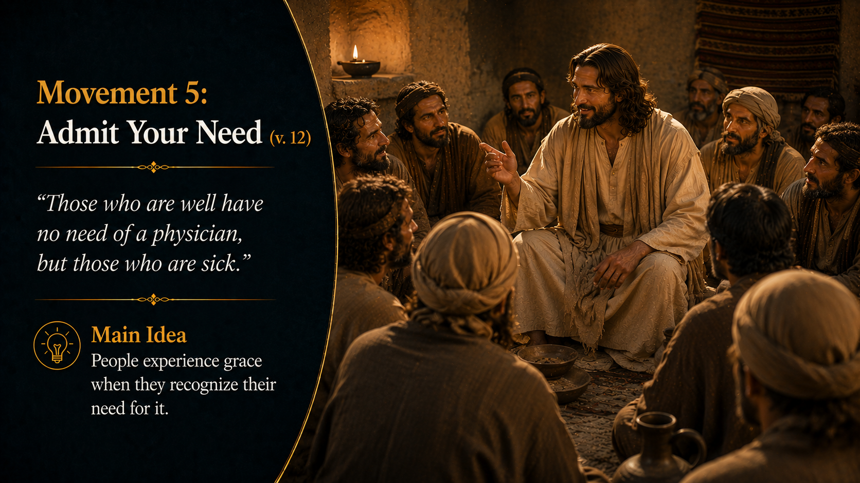
Notes:
The hardest person to save is the person who thinks he doesn’t need saving.
Jesus says He came for the sick.
The first step toward grace is recognizing our need for it.

Slide 56
Notes:
The gospel isn’t for perfect people.
It’s for people who know they are broken.
Every day, we must come to Christ with humility and dependence.

Slide 57
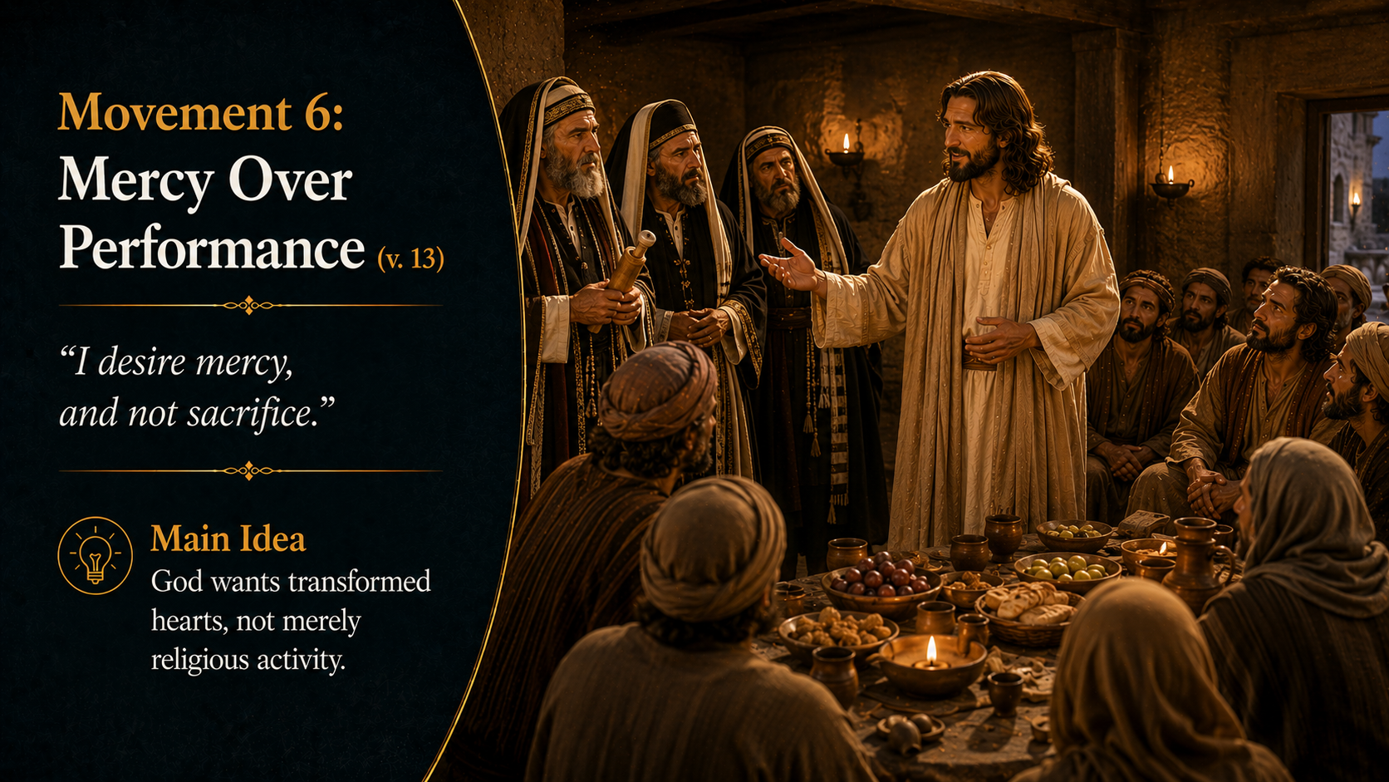
Notes:
The Pharisees were experts in religious activity but lacked mercy.
Jesus reminds them that God desires transformed hearts, not empty rituals.
It is possible to attend church, know Scripture, and perform religious duties while missing the heart of God.
Mercy toward others is evidence that we have personally experienced God's mercy.

Slide 58
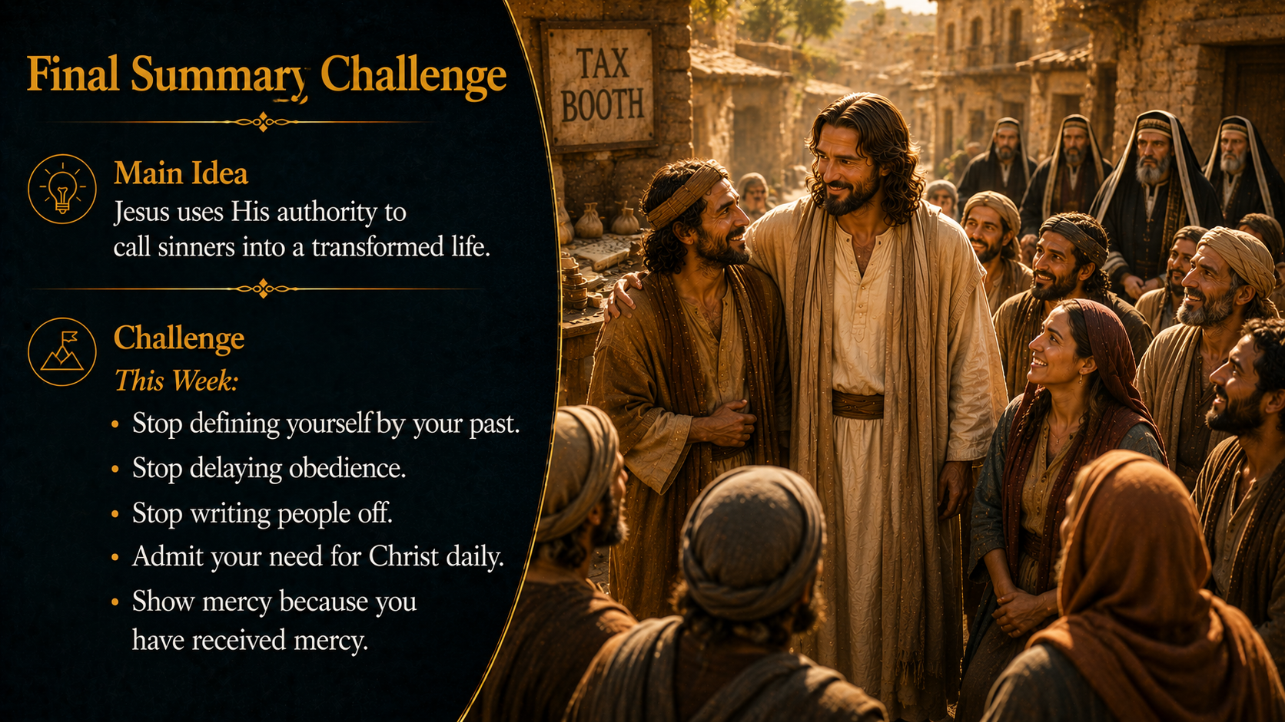

Slide 59
Notes:
Let's go back one final time to that banquet hall.
The room was full. Full of:
Managers.
Supervisors.
Respected employees.
People everyone admired.

Slide 60
Notes:
And then the doors opened.
In walked the man no one expected to see.
The man with the horrible reputation.
The man who had failed.
The man everyone believed had disqualified himself years ago.

Slide 61
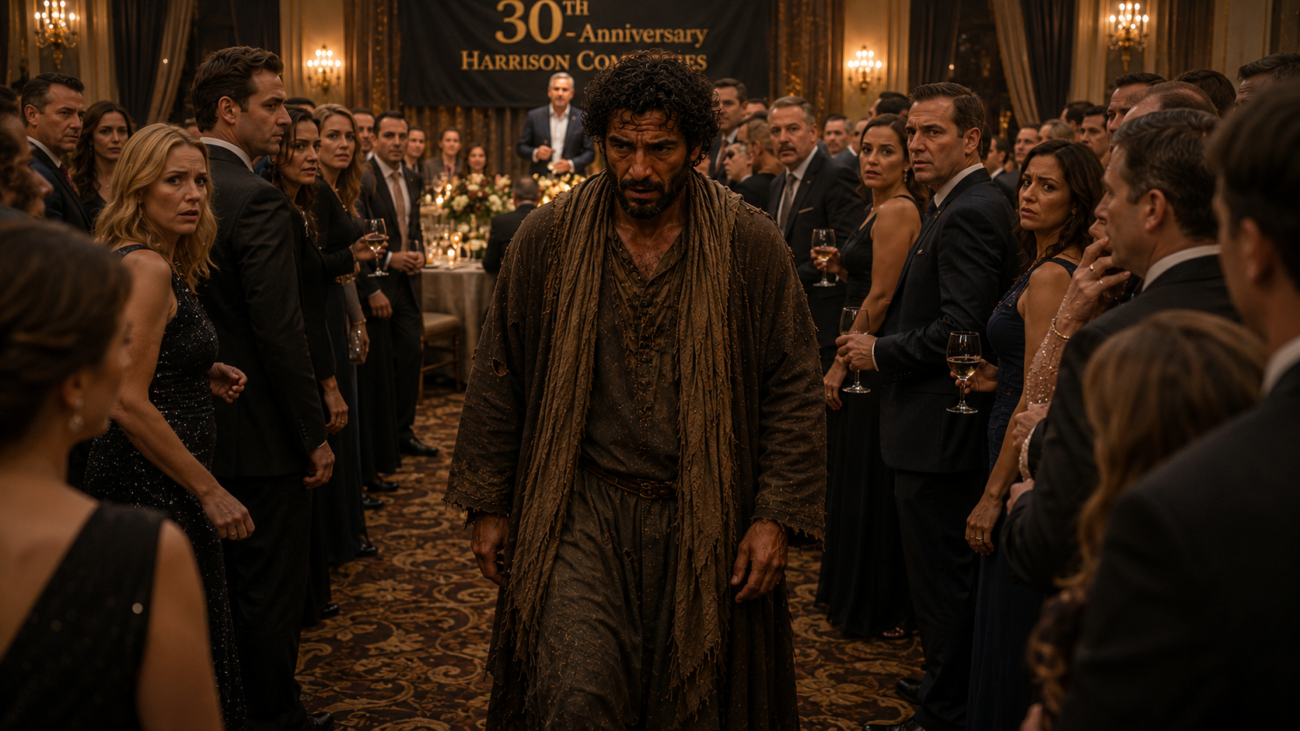
Notes:
As he walked into the room, he could feel all the eyes on him.
The whispers. The questions. The judgment.
He knew exactly what they were thinking because he had thought those same things about himself.

Slide 62
Notes:
"I don't belong here."
"I shouldn't have come."
"If these people knew everything about me, they'd really want me gone!"
Then he looked across the room and saw the owner.
The owner wasn't staring at him with disappointment.

Slide 63
Notes:
He wasn't shaking his head in disgust.
He wasn't questioning whether the invitation was a mistake.
Instead, he was smiling.
The owner walked across the room, straight toward him.
Greeted him and took him by the hand.

Slide 64
Notes:
And led him to his seat.
At that moment, the man finally understood something.
The invitation had never been about his worthiness.
It had always been about the grace and mercy of the one who invited him.

Slide 65
Notes:
And that is exactly what happened in Matthew 9.
Matthew was sitting at a tax booth.
Most people saw a traitor. Jesus saw a disciple.
Most people saw a sinner. Jesus saw someone who needed a Savior.

Slide 66
Notes:
Most people would have walked past. Jesus walked toward.
Most people would have condemned. Jesus called.
Most people would have built a wall. Jesus prepared a seat at the table.

Slide 67
Notes:
And when the religious leaders objected, Jesus revealed the heart of His mission:
"God’s mercy is for everyone who doesn’t deserve it."
That sentence isn’t just Matthew's story. It's our story.

Slide 68
Notes:
Every person in this room has more in common with Matthew than with the Pharisees.
We’re not the worthy, invited, or righteous guests. We’re the sinners.
We’re not the ones who earned a seat at the table. We’re the ones welcomed by grace.

Slide 69
Notes:
The world tells us that acceptance must be earned. The gospel tells us that mercy is never earned.
The world says clean yourself up first. Jesus says, "Follow Me first."
The world says your past defines you. Jesus says, "Come, and I will make you new.“
The world says you’re beyond hope. Jesus says, "I came for people exactly like you."

Slide 70
Notes:
Maybe today you feel like that man standing at the doorway of the banquet hall.
You know your failures. your regrets. the sins nobody else knows. the ways you've fallen short.
And perhaps you've spent years believing the invitation couldn't possibly be meant for you.
Matthew would tell you otherwise.

Slide 71
Notes:
Because one day, Jesus walked toward a tax booth and called the most unlikely man in town. And that same Jesus is still calling today.
The question of Matthew 9 isn’t whether Jesus calls the unworthy. He does.
The question is whether we’ll keep standing at the doorway, staring at the invitation in our hands...

Slide 72
Notes:
Or whether we’ll rise, leave the old life behind, and follow Him.
Because the seat at the table was never purchased by our goodness.
It was prepared by His mercy. And the invitation is always open.

Slide 73


